Slide 1





Meet The Teacher
Open Classroom
Miss O’Riordan

Slide 2




Classroom Expectations
Respect each other
  We will apologise if we have gotten something wrong
  We expect you to use your voice and be mature about conflict with friends
  Don’t bring what happens on your phone, into the classroom (unless it is very serious!)

Slide 3


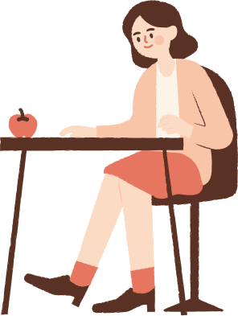
CLassroom Rules
-Be kind and respectful
-Use your words to explain
your feelings
-Work hard
-Ask for help if you need it
-Every day is a fresh start
You will always find help in the
classroom, if you work hard

Slide 4
Weekly Timetable
PE: Tues with me and Wednesdays with Coach Tom
Music: Tuesday 2.30pm
Hymn practice: Friday 1pm
Residential: December
SATS: May

Slide 5
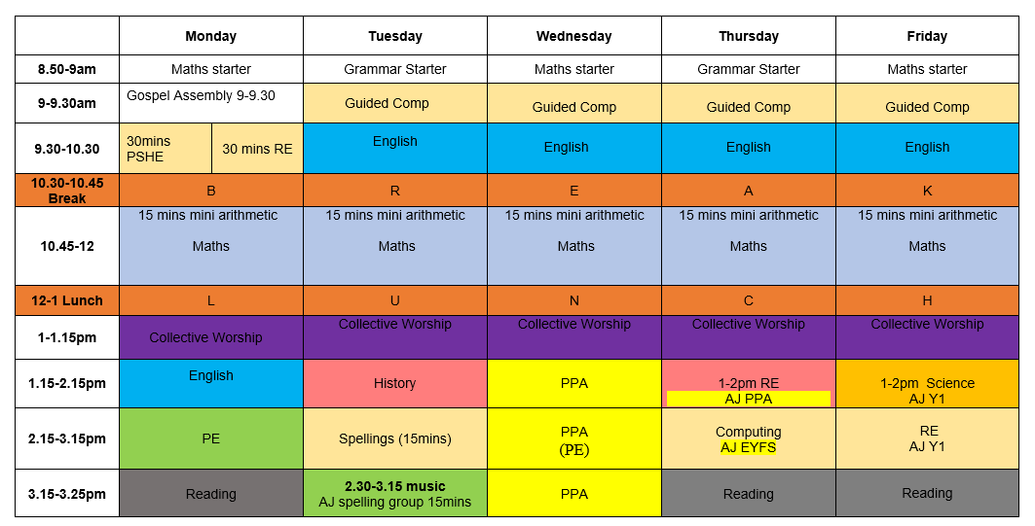
Weekly Timetable

Slide 6

Reading Records + Homework
Reading records signed by you 4 times a week and an adult at least once a week.
Homework given out on a Thursday and handed in on Monday. It must be completed to a high standard. Late homework might not be marked. If it’s not done, it’s a you problem, not a me problem!
Battersea Park Library is a fantastic free resource, I highly reccomend. There is a quiet space for homework, workshops and of course, fantastic books! The library staff are incredibly helpful, please do make use of this resource.

Slide 7
School Uniform
Black shoes, not trainers. Correct uniform on the correct day and we will have no issues!
https://www.stmarysschoolbattersea.co.uk/school%20uniform/

Slide 8
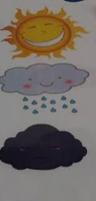
Behaviour System
We continue to use the school wide behaviour
system, with the storm cloud being increments of
5minutes for detention with Mrs Mitchell on Friday.
I have a prize box for
other times when children go
above and beyond!

Slide 9
SATS
A long way away yet!
Spelling, Grammar, Reading,
Maths 1, Maths 2, Maths 3
I promise you will be well prepared!
We will do many practice rounds and I will
share results are parents evening.

Slide 10
Family Learning
There will be family learning sessions throughout the year. Maths, reading and writing usually. I will send you the dates once I have them.

Slide 11
Spellings
Why a change?
Writing places significant demands on children. They must generate and organise ideas, construct sentences, sustain attention, monitor their work and simultaneously manage spelling, punctuation and handwriting.
The DfE’s Writing Framework places strong emphasis on transcription because spelling and handwriting need to become increasingly automatic. When they are not automatic, there are too many things to think about! .

Slide 12
Spellings
Teaching sequence:
Lesson 1: (45 min English lesson) Introduce the words. Talk about the tricky bits. Model any trick and tips you think will help. Link to handwriting.
There are children who perform well in weekly spelling tests and even SATs tests, but are not spelling at age related expectations in their writing.
Lesson 2: (15 - 20 min spelling lesson) Deliberate practice through games etc
Lesson 3: (30 mins spelling lesson) Dictation
Lesson 4: Test. High expectations of handwriting. “Mark”. Correct. Add to pupil spelling books if necessary.

Slide 13
Trips
Ragged School Museum: 6th October
High Ashurst Residential: 2nd December

Slide 14
Have you any questions for me or Ms Jordan or about year 6?

Slide 15
Collective Worship
Prayer for the start of
a new school year
Gracious and loving God,
We come to You as a new school year begins, lifting up our children and our homes. Thank you for the gift of our children and the opportunity for them to learn, grow, and discover the world You made. Amen
Children plan and deliver collective worship once
a week. They use the Wednesday Word to help them.
You can encourage your child by reading the Wednesday Word at home and discussing the questions

