Slide 1

Wednesday 16th September 2026
Welcome to Year 5 Open Classroom
From small seeds, great lives grow.

Slide 2

Meet the team:
Class teacher: Mrs Jerry
Class TA: Mrs Viegas

Slide 3

On the first day of Year 5, we created our own class rules and signed them promising we would would try our best each day to follow them.

Slide 4

At St Mary’s, behaviour is rooted from the teaching of Gospel Values and of the Catholic Church into every aspect of learning. This term, our focus will be ‘dignity’.
Dignity: every person is valuable, important and deserves to be treated with respect.
Behaviour Policy

Slide 5
Behaviour Policy
-Sun, warning 1 and 2 clouds
- Class Dojo
- Raffle tickets
- Learning behaviour certificates (termly)
-Hot chocolate/ice lolly Friday

Slide 6
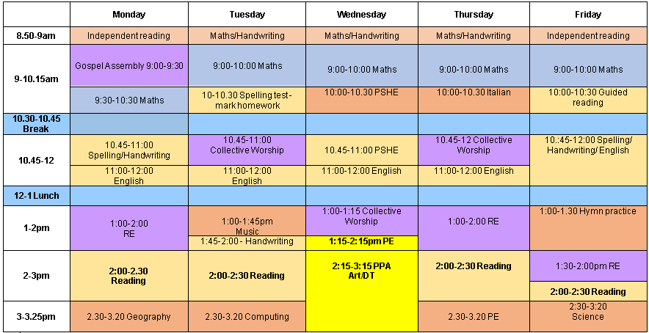

Slide 7

Reading for pleasure
We are focusing on reading for pleasure – helping children discover the joy and excitement that books can bring.
Research shows that reading for pleasure can:
Improve vocabulary and writing skills
Strengthen imagination and creativity
Support emotional wellbeing
Boost academic success across all subjects
We encourage you to spend a little time each day sharing stories, talking about books, and letting your child choose what they enjoy reading. Together, we can nurture a lifelong love of reading!

Slide 8
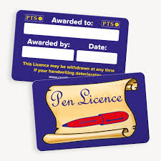

Goals
Pen licence
144 club

Slide 9

Our new approach to spelling and writing this year:
Our main goal is simple: we want children to spell accurately in their independent writing, not just perform well on a weekly test. To achieve this, our curriculum gives children targeted, deliberate practice with commonly misspelled words, high-frequency words, and key phase word lists
Rather than assigning generic word lists, we analyse your children's daily work to identify the exact words and patterns causing issues.
Targeted Lists: Children work on 10–15 core words per ensuring high exposure to words they frequently encounter.
Handwriting Integration: Spelling is explicitly linked to joined handwriting practice. Connecting muscular memory with letter patterns locks in correct spelling.
Focused Writing Curriculum: We have adapted our weekly schedule to ensure dedicated, high-impact time for spelling mastery without rushing writing tasks.

Slide 10
Lesson 1: Introduce, analyse & link to handwriting:
We introduce the week's focal words and dissect the "tricky bits" together. Quick Wins vs. Slow Wins: Children sort words into "Quick Wins" (words using predictable patterns) and "Slow Wins" (words requiring special strategies or memory hooks).
Lesson 2: Deliberate practice.
Targeted Repetition: Students engage in structured, focused practice on the specific parts of words they find challenging. Building Fluency: Practice moves beyond simple copying to active recall and application in short phrases.
Lesson 3:Dictation Practice:
Words are dictated within complete, meaningful sentences rather than isolated lists. Bridging to Writing: This trains children to retrieve correct spellings automatically while managing punctuation, grammar, and sentence structure.
Lesson 4:Assessment, marking & correction.
Students complete their weekly check with a strong focus on presentation and clear, correct handwriting joins. Tests are marked and corrected immediately so pupils analyse errors while the learning is fresh.

Slide 11
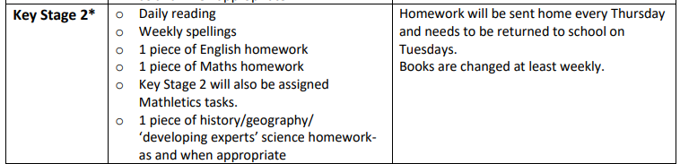
Homework
-Sent out on Thursday, returned on Tuesday. Spelling tests will be on Tuesday mornings.
-Mathletics to be completed, if a device is an issue, then let us know.
-Reading record signed daily, either by adult or child. Adults must sign it at least once a week.
-Reading books will be changed and monitored when needed.

Slide 12
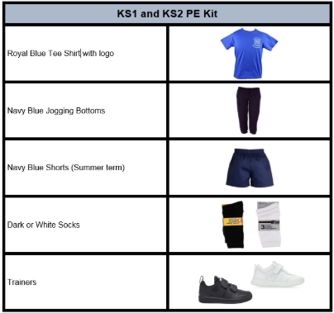
PE days are Wednesday and Thursday.

Slide 13

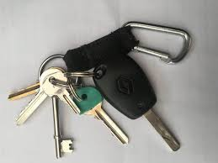

Personal belongings
If your child needs to bring a phone or keys to school, these must be placed in the phone box, which will be kept safely in the school office.
We kindly ask that children do not bring in personal belongings such as stationery or toys. These can cause unnecessary disruptions to learning, and staff cannot be responsible for any loss or damage.

Slide 14
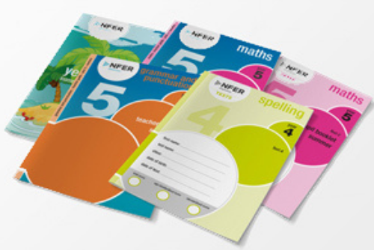

Assessments
NFER
These take place at the end of each term and consist of:
1 spelling
1 Grammar
1 reading comprehension (over 3 different texts)
1 Arithmetic
2 maths reasoning.
Writing assessments in English every half term. This term, your child’s writing will be assessed through a diary entry from the book ‘Skellig’.

Slide 15

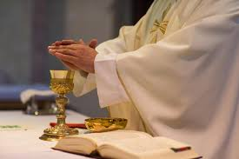

Dates for the diary
Start of term Mass: Wednesday 23rd September 10am at Our Lady of Mount Carmel Church
Year 5 class assembly: Thursday 3rd October 9am
Oppurtunities for museum visits over each term to tie in with our curriculum

Slide 16


Slide 17

Prayer
Loving God,
We thank You for gathering us here at the start of this new academic year.
Bless our children as they learn and grow,
our parents as they support and guide,
and our staff as they teach and care.
Fill our classroom with friendship, respect and joy.
Help us to live out the Gospel value of dignity,
treating each other with kindness and love.
May this year be filled with learning, laughter and faith.
Amen

