Slide 1

Year 4 open classroom
Monday21st September

Slide 2

The Year 4 team
Ms Hunt
Ms Barbara

Slide 3
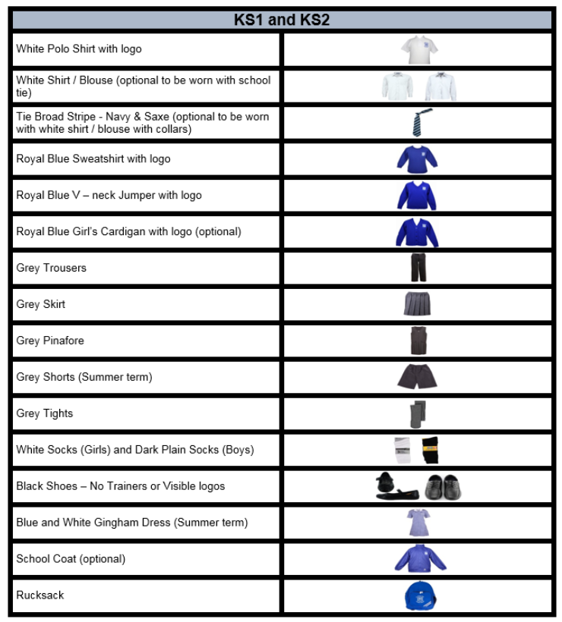
Expectations
On the first day of Year 4 we created some class rules

Slide 4

Behaviour systems in Year 4
Star, sun and clouds
Class Dojo
Certificates
Hot chocolate Friday/ ice lolly Friday

Slide 5
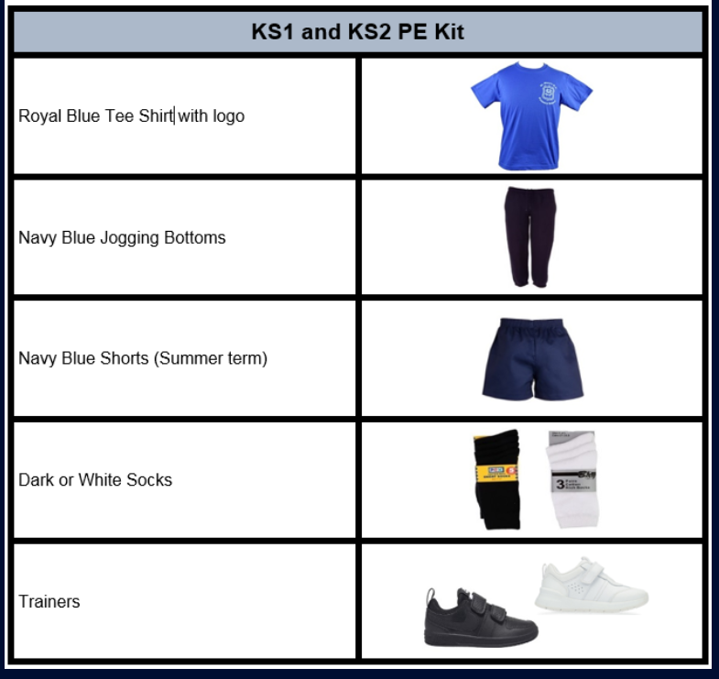
PE days
Monday
Wednesday

Slide 6

Homework and reading
Reading is to be done daily and reading records are to be signed by an adult/ pupil
Children have access to book corner and school library to find new texts
Homework is sent out on a Thursday and is to be returned on a Tuesday
  English
  Maths
  Timestables sheet
  Spellings
  Mathletics
  TT Rockstars

Slide 7

Important dates
Year 4 class assembly Wednesday 8th October
Thursday 22nd October- Trip to British Museum
Thursday 19th November- National Gallery visit
Year 4 MTC- June

Slide 8

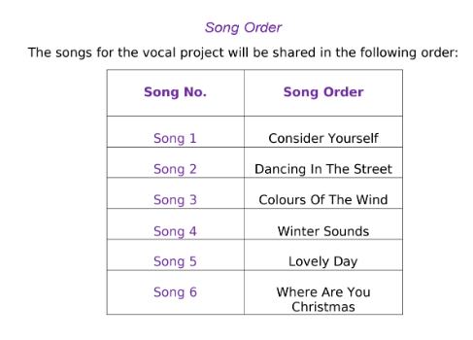
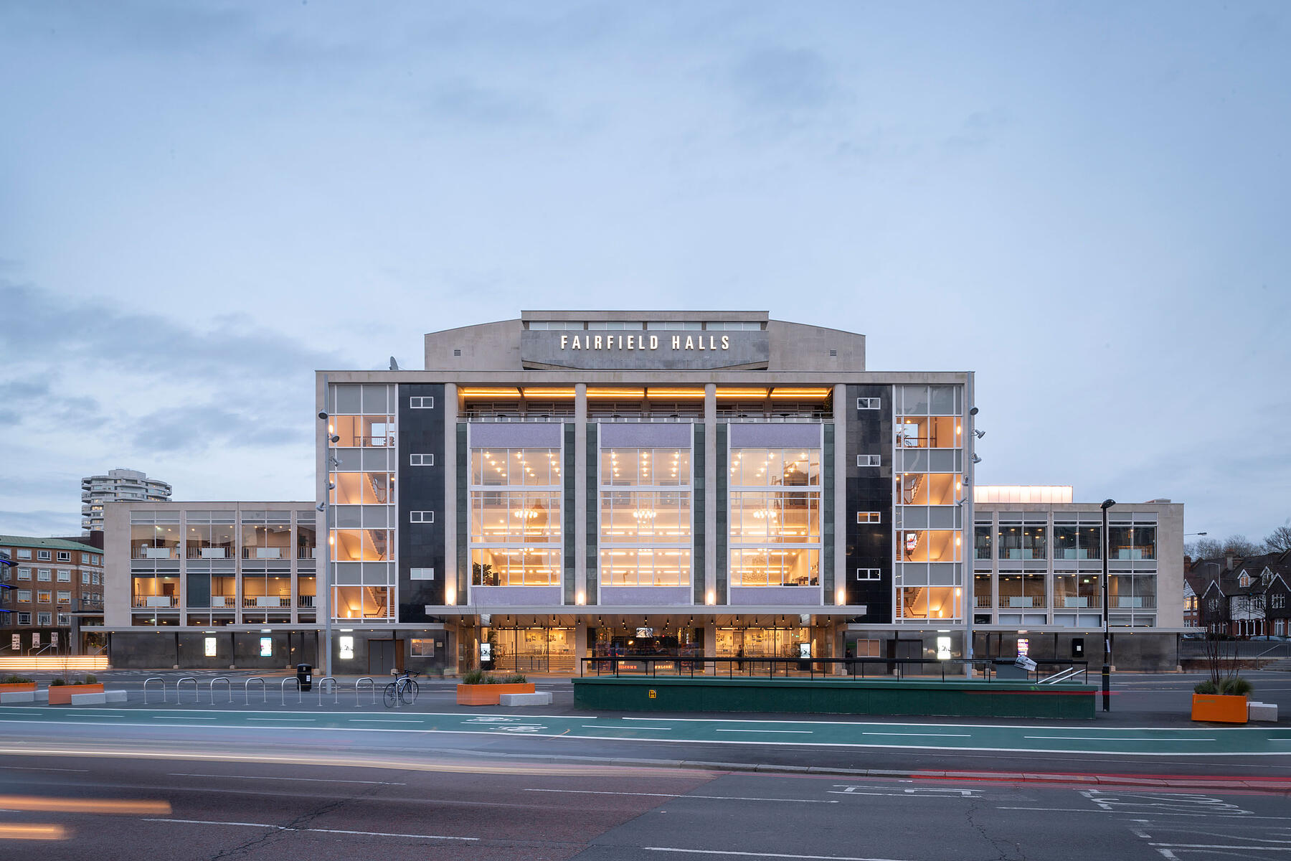
Fairfield Halls- Wednesday 9th December

