Slide 1

Year 3 open classroom
Wednesday 23rd September 2026

Slide 2

The Year 3 team
Miss. Bebas
Mrs. Payne
Mrs. Kelly

Slide 3
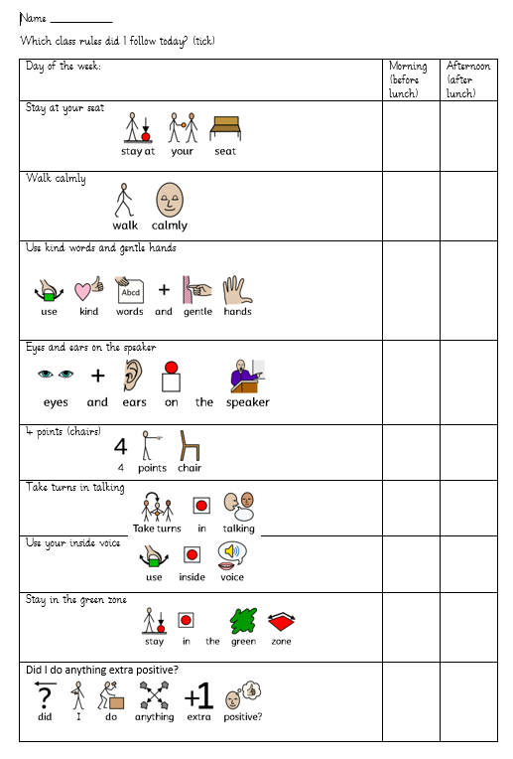
Class rules in Year 3
On the first day of Year 3 we created some class rules and we reflect on them at the end of every day.
We are a zones of regulation school.

Slide 4

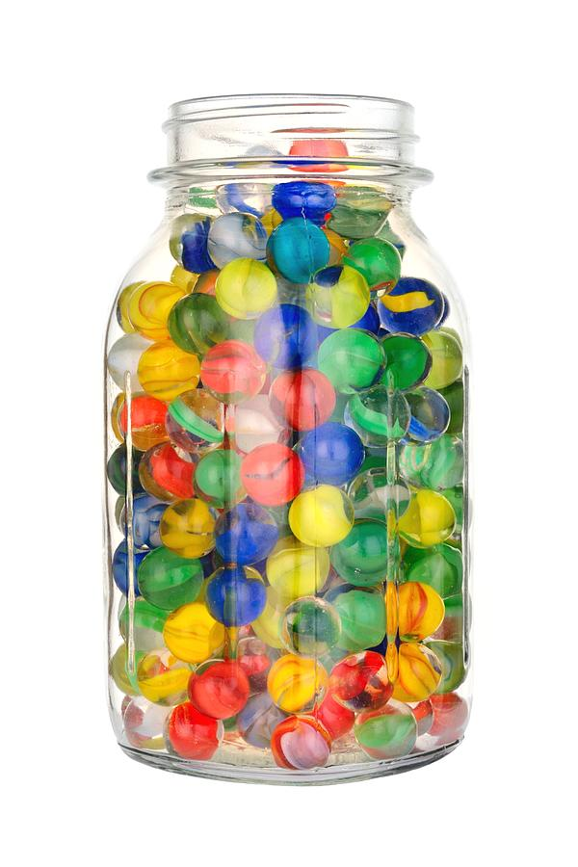
Behaviour systems in Year 3
Star, sun and clouds
Class Dojo
Whole Class Marble Jar (100 marbles to collect)
Hot chocolate Friday/ Ice lolly Friday
Praising positive behaviour

Slide 5


Year 3 Goals
Pen License
Joining the 144 club (knowing all their times tables)

Slide 6
Assessments
NFER tests at the end of each term
  X2 Reading Comprehension
  X3 Maths (Arithmetic and Reasoning)
  X1 SPaG

Slide 7
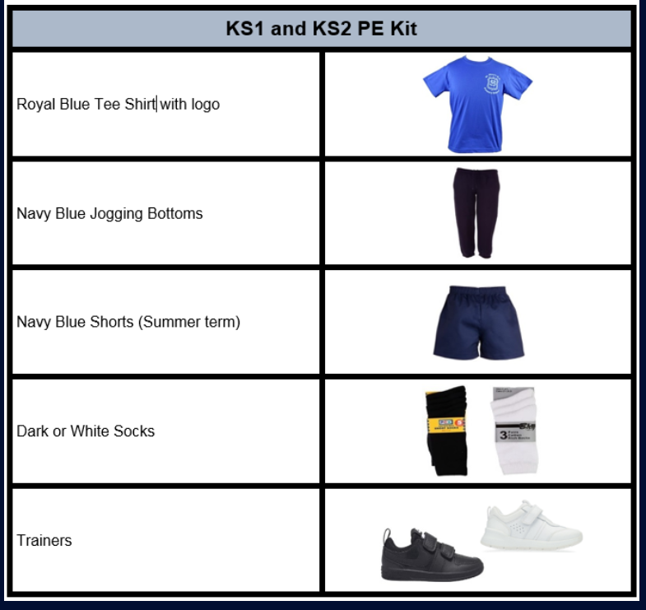
PE days
Wednesday (Coach Ash)
Thursday (Miss Bebas)
Safety first: no earrings
to be worn. Thank you

Slide 8

Reading
Reading is to be done daily and reading records are to be signed by an adult
Books will be changed weekly for levelled readers and weekly for free readers (or when they finish reading)
Rapid Catch Up with ‘Little Wandle Letters and Sounds’ for those who are not secure with all their phonemes.

Slide 9
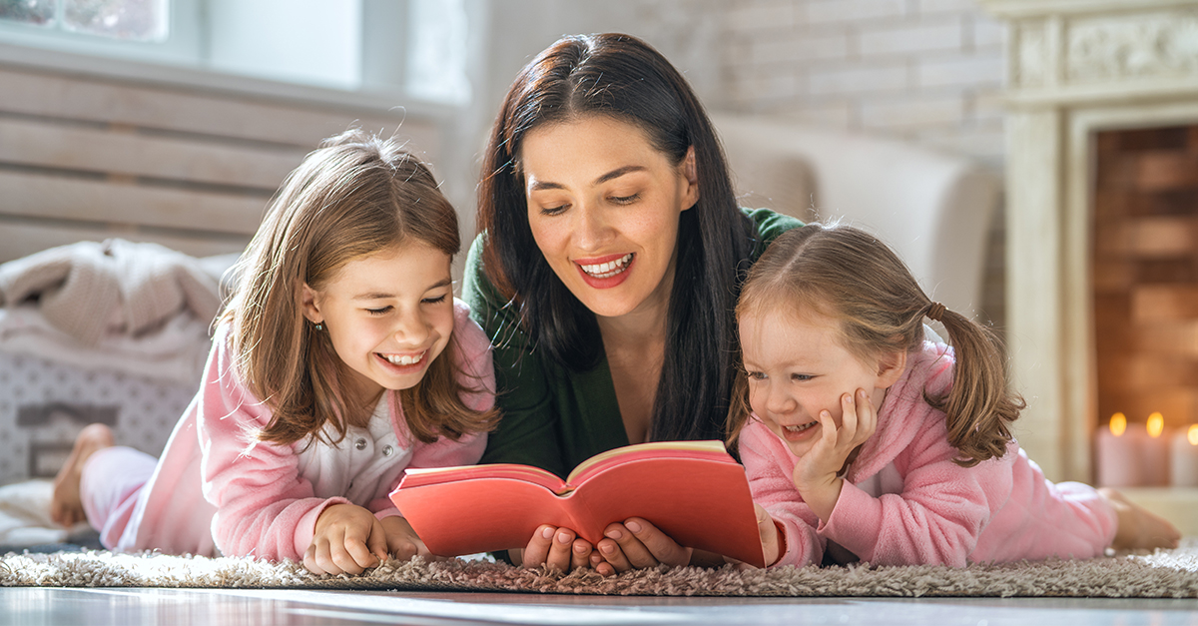
Reading for pleasure
Builds a Love of Learning
When kids enjoy reading, they see books as fun—not just schoolwork. That positive attitude can carry over into other areas of learning.
Boosts Language and Communication
Regular reading grows vocabulary, improves grammar, and helps children express themselves more clearly.
Strengthens Imagination and Creativity
Stories transport kids to different worlds, encouraging them to dream big and think creatively.
Improves Focus and Patience
Reading requires kids to sit, follow along, and stick with a story—skills that also help with homework and daily routines.
Supports Emotional Growth
Books introduce children to different feelings, perspectives, and experiences, helping them build empathy.
Family Bonding
Sharing books together—whether bedtime stories or trips to the library—creates special moments and lasting memories.

Slide 10
Homework
Handed out on Thursday, returned following Tuesday

Slide 11
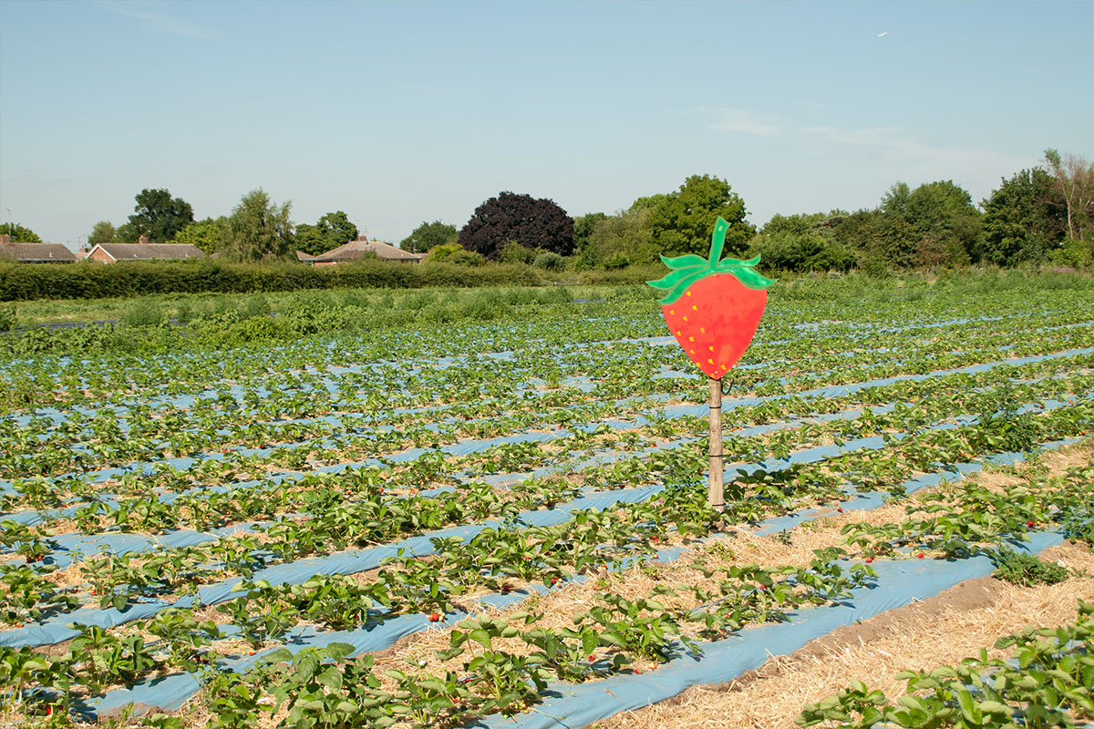
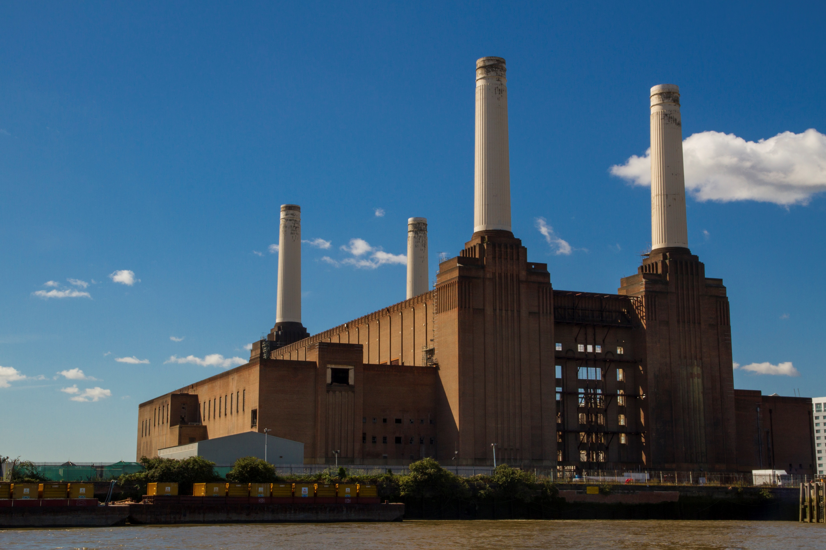
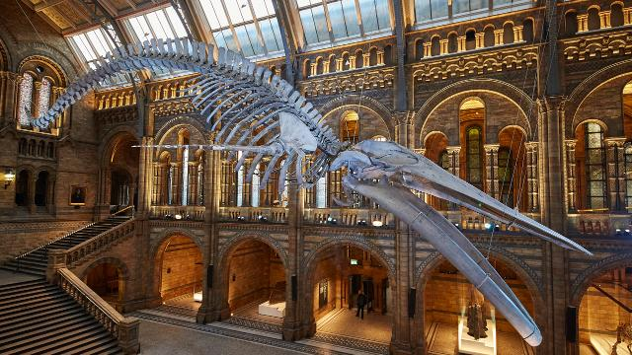
Trips in Year 3
Trips in Year 3 over the past 2 years have included: Natural History Museum, Battersea Power Station, Battersea Park, Hampton Court Palace, City Farm

Slide 12

Important dates
Year 3 class assembly: Thursday October 15th

Slide 13
We are here for you and your children so please do not hesitate to ask.

Slide 14
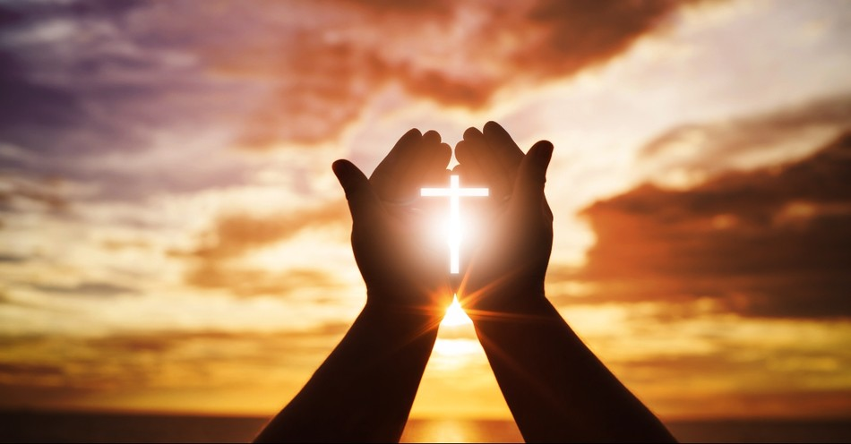
Prayer
Loving God,
We thank You for bringing us together today—parents, teachers, and children—
to begin this new school year as one community.
Bless our students with curiosity to learn,
courage to try, and kindness to share.
Bless our parents with wisdom and patience
as they guide and support their children.
May our school be a place of safety, joy, and growth.
Help us work together in trust and love,
so that every child may flourish.
In Jesus name we pray,
Amen.

