Slide 1

YEAR 1 OPEN CLASSROOM
Monday 28th September 2026

Slide 2

The Year 1 team
Miss Sambi
Miss Fifi
Miss Jess (Tuesday & Friday)
Ms Galvis (NEST)
Miss Rachel

Slide 3

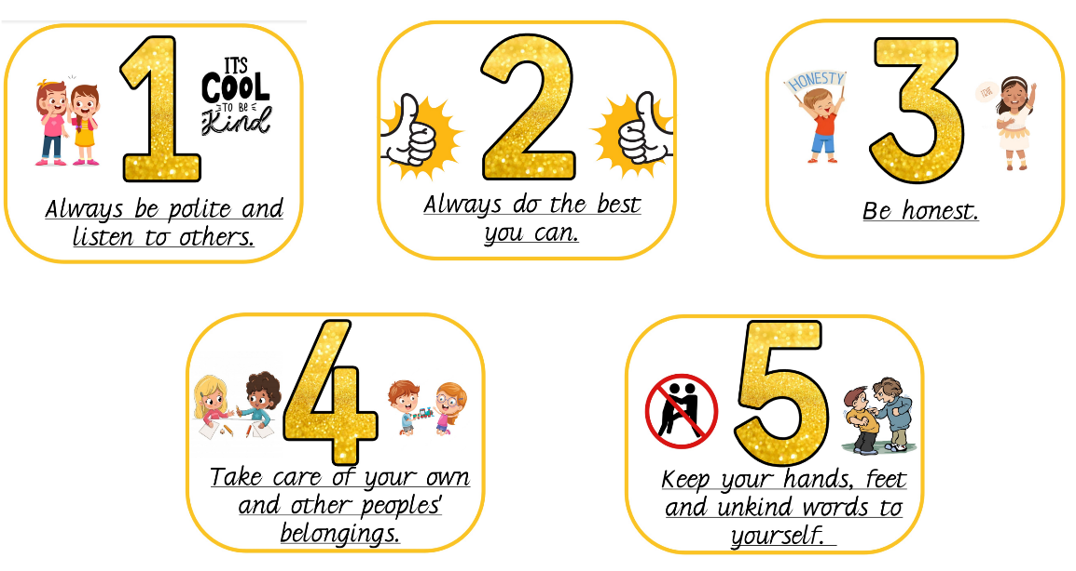
Our class rules in Year 1
On the first day of Year 1 we collaborated as a class to think of some class rules that we thought were important.
Notes:
These golden rules can be applied in school and in the wider world and at home.

Slide 4

Behaviour systems in Year 1
We primarily use positive reinforcement in Year 1.
Star, sun and clouds
Class Dojo
Pupil of the day
Certificates/ stickers
Hot chocolate/ Ice lolly Friday

Slide 5
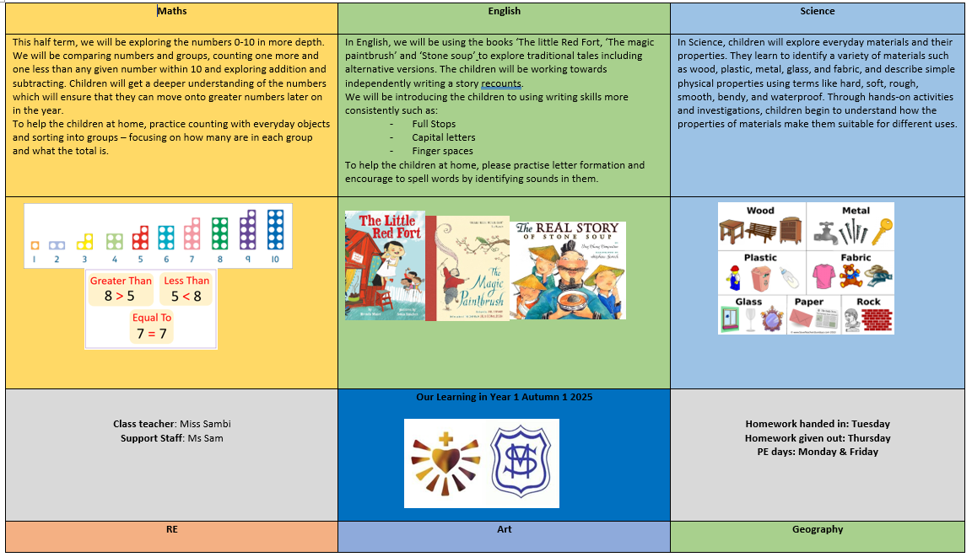
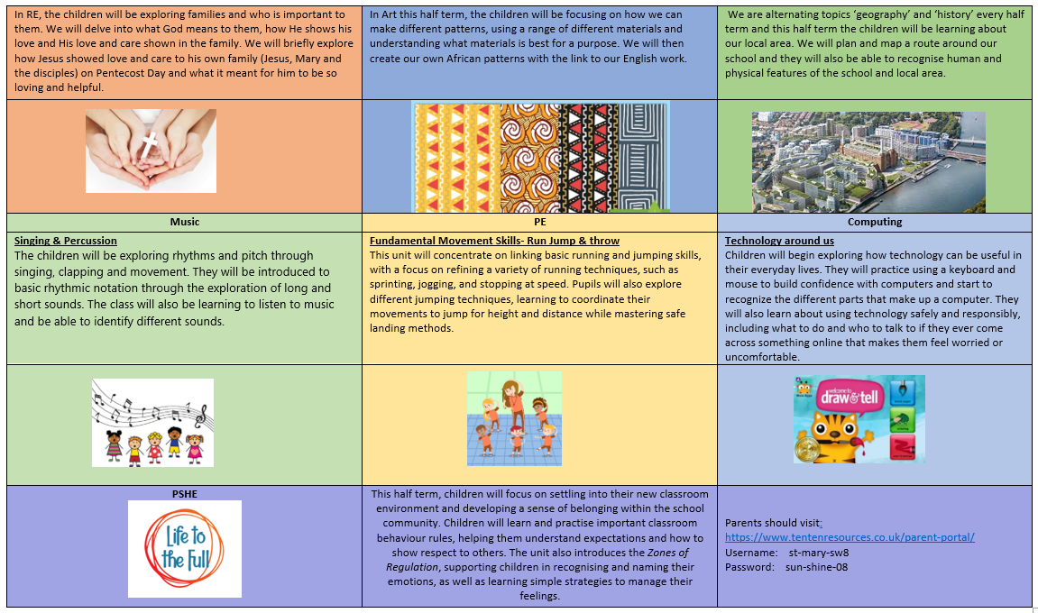
Half termly Parent Overviews
Notes:
We will send you half termly overviews so you can see what your child will learn each half term

Slide 6

Phonics
Phonics gives children the skills they need to read and spell confidently. In Year 1, we follow the Little Wandle phonics scheme, where children learn to recognise sounds, blend them to read words and segment them to spell.
At the end of Year 1, children complete the Phonics Screening Check, which checks their ability to use these skills to read words. It is a short, informal check and helps us identify if any children need additional support.
Regular reading and practising phonics at home can make a big difference to your child’s confidence and progress.
Notes:
Phonics is an important part of learning to read and spell. In Year 1, children continue to build their knowledge of sounds and the letters that represent them through our Little Wandle Letters and Sounds Revised phonics programme.
Phonics helps children to:
Read unfamiliar words by sounding them out and blending the sounds together.
Develop confidence and fluency when reading.
Spell words by segmenting them into sounds.
Build a strong foundation for becoming independent readers and writers.

Slide 7

Reading
Reading is to be done daily and reading records are to be signed by an adult. We will be sending a book home that matches their phonic knowledge and a book for pleasure.
Reading books must be brought in EVERYDAY as we use them in our reading practise sessions. Any lost or damaged books will require you to pay a fee to cover the cost of the book.
Commenting in the reading record is very important. This is our communication
Notes:
Your comments help us see how your child is progressing with their reading at home. They allow us to know which words or sounds your child found tricky, as well as what they enjoyed and are becoming confident with.
Sharing this information helps us support your child’s reading development in school and work together to build their confidence and love of reading.
Every comment, however brief, helps us understand and support your child.
I created a document ‘How to comment in a reading record’ to help you on the kind of things to write about.

Slide 8

Homework
Homework is sent out on a Thursday and is to be returned on a Tuesday.
Handwriting, English, Maths, Topic, Spellings
We have high standards of presentation; children should be practising sitting at a table, writing on the line and forming their letters correctly.
Children should be writing in pencil. Not pen or colouring pencils
Don’t do the homework for your child. Your encouragement and praise are more valuable than getting every answer right!
Notes:
We use our little wandle mnemonics to help form letters, making sure children start and finish in the correct place. This helps a smoother transition into cursive joined up writing.
Homework gives children the opportunity to practise and reinforce the skills they are learning in school. It helps build confidence, independence and good learning habits.
Parents can support by encouraging and guiding their child, but please avoid doing the homework for them. It is important that children have a chance to think, try and make mistakes independently.
Your encouragement and praise are more valuable than getting every answer right!

Slide 9
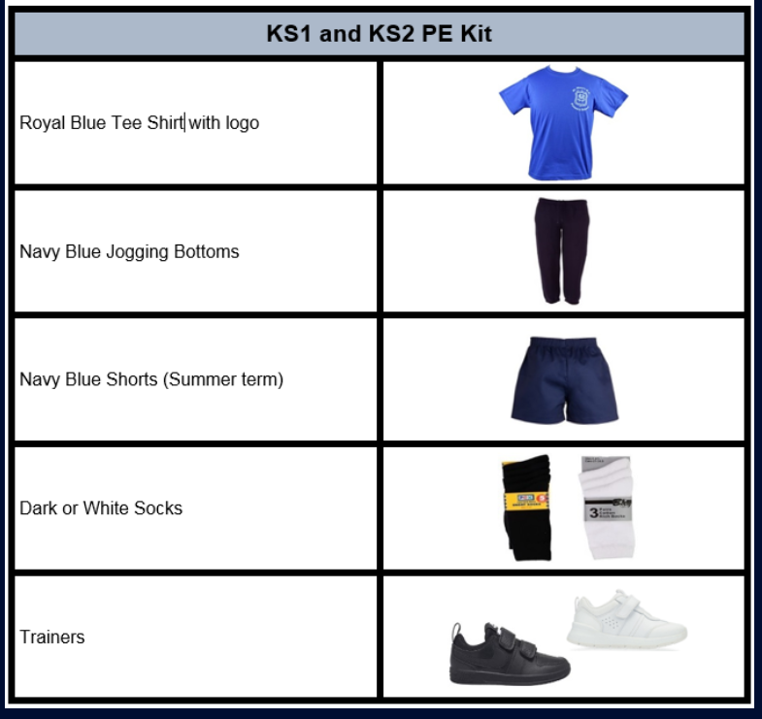
PE days
Thursday & Friday
Label EVERYTHING!
Trainers must be appropriate for sport not fashion.
(if trainers have laces, please teach your child how to tie them)
Notes:
It is also written on the half termly overview. PE days can change due to a class swap so please keep an eye on class dojo for any changed that week. Children should practise at home to tie shoe laces, if children have not learnt how to tie laces for safety wear Velcro shoes. Not multi coloured shoes.

Slide 10
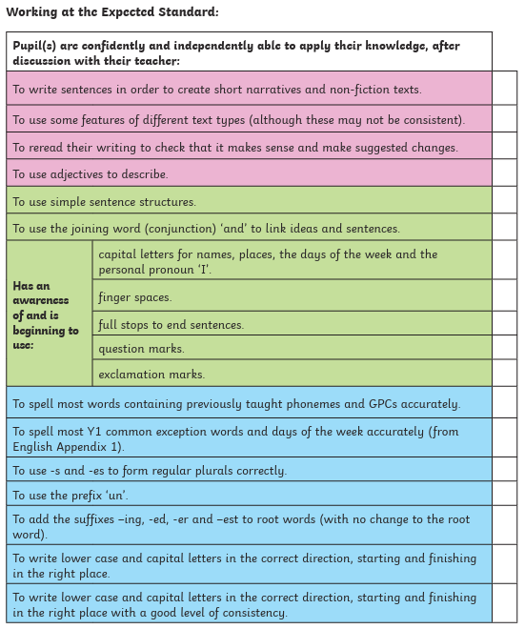
Writing expectations for Year 1
We will be working throughout the year to build these skills.
This is what a child needs to be able to do independently by the end of year 1 to be ‘on track’ for the expected standard in year 2.

Slide 11
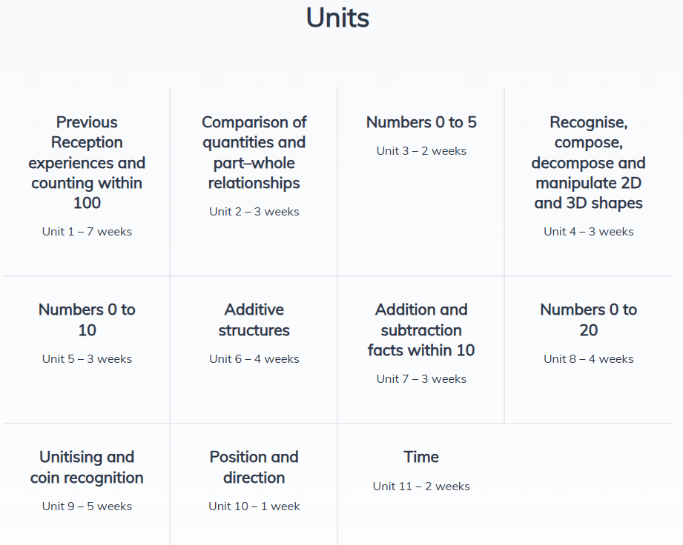

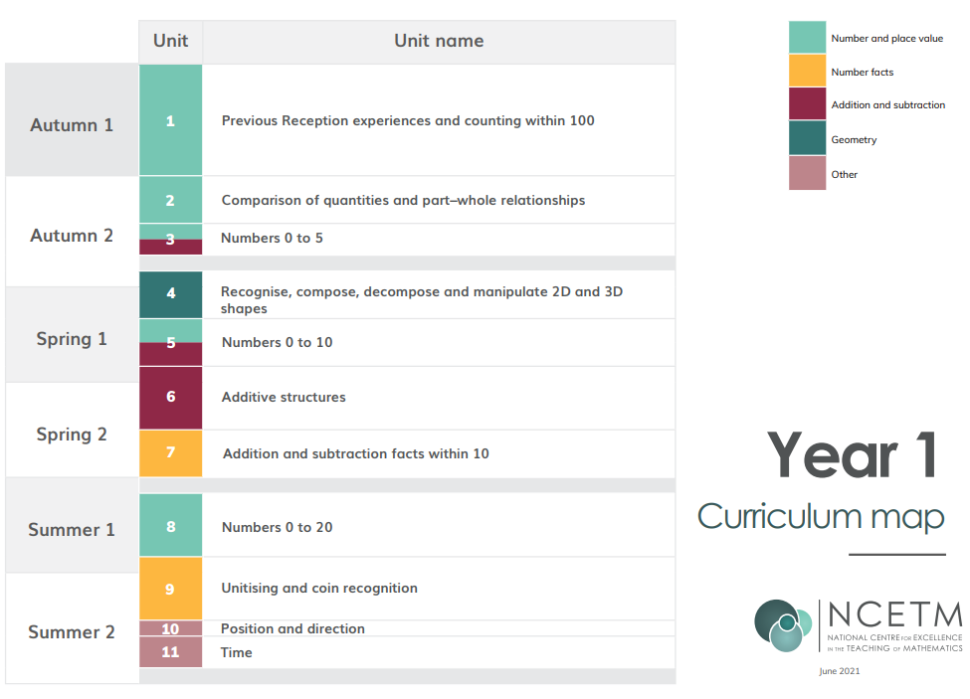
Maths
We will cover these units throughout the year
Notes:
The graphic above shows the year mapped into different areas of the curriculum, to give an idea of the time that should be spent on each unit.

Slide 12
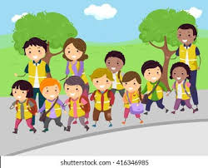
Trips
We will be going on some exciting trips throughout the year.
There may be times we need parent volunteers. If this is the case, I will send a message asking for names (numbers may be limited depending on the trip)
Notes:
Please note that other young children/ babies cannot be brought in addition on trips. This is for safety of the children and ratios.
Before attending a trip, if you are selected there will be a form to fill out that explains your role and responsibility. The main focus is the safely of the children. You might not be in the same group as your child, you should follow the class teachers instructions and adhere to the school rules. Even if another child might be friends with yours.

Slide 13

Birthdays
We love to celebrate any special day.
We are steering away from cupcakes and hoping you'll opt for a healthier substitute. E.g. donate a book to the class library, give out stickers or pencils, a fruit snack etc.
This makes celebrating birthdays inclusive and safe for all, even for children that have dietary requirements and allergies.
Notes:
Please note that we do not hold whole class parties for birthdays

