Slide 1

Welcome to Reception!

Slide 2
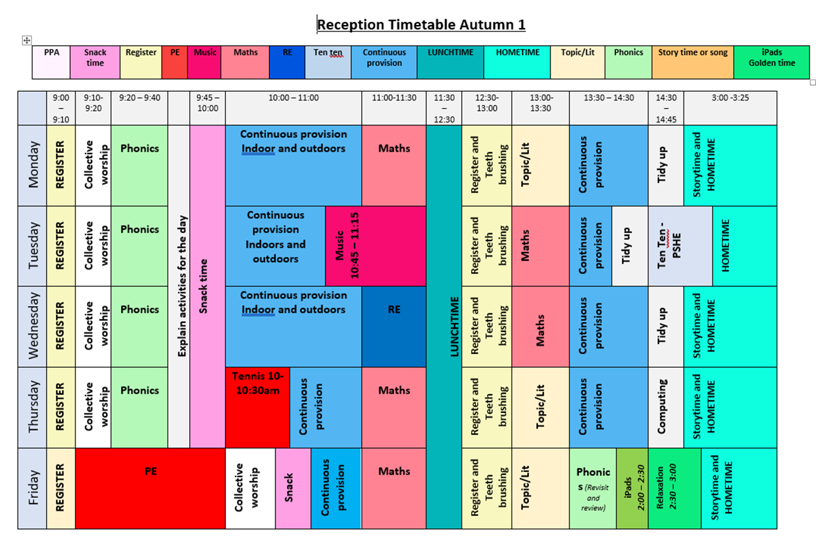

Slide 3
The Early Years Foundation Stage
The Three Prime Areas of Learning and Development
The three prime areas are the foundations of children’s early learning and development. They help children build confidence, independence and the skills they need to learn and develop.
They break down into..

Slide 4

Personal, Social and Emotional Development
This area helps children to:
Develop confidence and self-esteem.
Understand and manage their feelings.
Build positive relationships with adults and other children.
Learn to share, take turns and cooperate.
Develop independence and resilience.
Understand boundaries and routines.
Parents can help by talking about feelings, encouraging independence, praising effort, sharing stories and giving children small responsibilities at home.

Slide 5

Communication and Language
This area helps children to:
Develop listening and attention skills.
Learn and use new vocabulary.
Express their thoughts, ideas and feelings.
Develop confidence when speaking with others.
Understand and follow instructions.
Enjoy and talk about stories, rhymes and conversations.
Parents can help by talking with children, sharing stories every day, introducing new words, singing songs and rhymes, asking questions and encouraging children to talk about their experiences.

Slide 6

Physical Development
This area helps children to:
Develop strength, balance and coordination.
Build confidence in moving and exploring.
Develop fine motor skills for writing and using tools.
Develop gross motor skills through running, climbing and playing.
Become increasingly independent with dressing and personal care.
Understand the importance of keeping healthy and active.
Parents can help by providing opportunities for active play, encouraging children to dress themselves, practising using pencils and scissors, playing outdoors and involving children in everyday tasks such as cooking and tidying.

Slide 7
Communication and Language | Physical Development | Personal, Social and Emotional Development (PSED)
Listening to stories and responding with questions and comments. Join in with class discussions offering their ideas. Expressing themselves with full sentences. Singing songs and rhymes together to build vocabulary. | Gross motor: Climbing, balancing, and crawling in outdoor play. Using equipment such as balls and hoops with more control. Fine Motor: Holding a pen or pencil effectively Using a variety of small tools with control. Developing accuracy. | Show an understanding of their own and others feelings. Understanding the classroom rules and routine. Managing their own personal needs. Building friendships and working cooperatively with others.

Slide 8
The Early Years Foundation Stage
Four Specific Areas –
Literacy – including phonics, reading, and writing.
Children will enjoy daily stories, songs and rhymes, take part in phonics sessions and have opportunities to read and write throughout the day. You may see children writing shopping lists in the role-play area, labelling their pictures or choosing books to share with friends.
Mathematics – including number, shape, space and measure.
Maths will be explored through both adult-led activities and play. Children might count objects, build with blocks, create patterns, sort shapes or solve simple problems. Maths is also part of everyday routines, such as counting children, sharing resources and comparing sizes.
Understanding of the world – including people and communities, the world, technology.
Expressive arts and design – including exploring media and materials and being imaginative.

Slide 9
Understanding of the world – including people and communities, the world, technology.
Children will learn through exploring, investigating and asking questions. They might observe changes in plants, explore insects outdoors, talk about their families and communities, investigate how things work or use technology to support their learning
Expressive arts and design – including exploring media and materials and being imaginative.
Children will have plenty of opportunities to create, imagine and express themselves. They might paint, draw, build, make models, explore music and instruments, dance or develop imaginative stories through role play. Children are encouraged to explore materials and share their own ideas.

Slide 10
Literacy | Mathematics | Understanding the world | Expressive arts and design
Write recognisable letters, formed correctly. Spell words by sounding out. Say a sound for each letter and 10 diagraphs. Show an understanding of what has been read to them, retell stories in their own words, use new vocabulary. | Have a deep understanding of numbers 0-10, including number bonds. Subitise numbers 0-5. Count beyond 20, recognising the counting system. Explore pattern in numbers, odds and evens, numbers facts to 10. | Exploring nature in the garden – looking for bugs, leaves, or sticks. Planting seeds and helping them grow. Using simple technology such as a camera or tablet to take pictures. | Junk modelling with boxes, tubes, and tape. Making music with instruments, exploring loud and quiet sounds. Painting and drawing freely to express ideas and feelings.

Slide 11

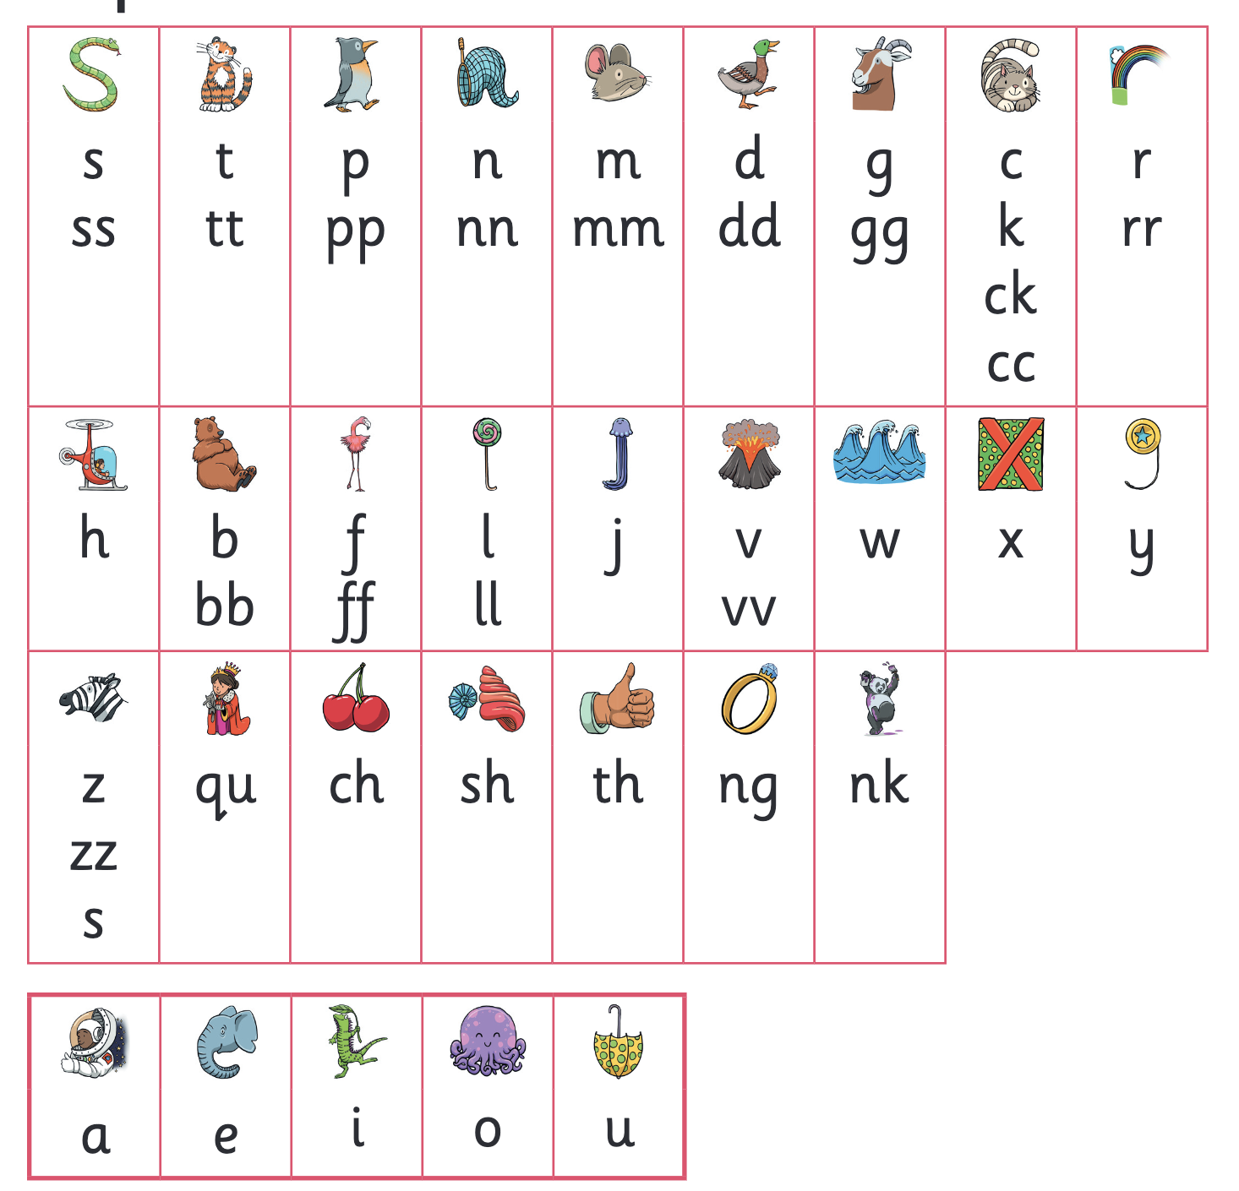
Phonics & Early Reading
Little Wandle Letters & Sounds
Phonics is making connections between the sounds of our spoken words and the letters that are used to write them down.
Our school has chosen
Little Wandle Letters and Sounds Revised as our Systematic Synthetic Phonics (SSP) programme to teach early reading and spelling.
https://www.littlewandle.org.uk/resources/for-parents/
https://www.youtube.com/watch?v=zCKu-m-8czk&list=PLBylnf4b6qQvsCziWw816PVJ7ye7ef9gO

Slide 12
Maths
In Reception, we use White Rose Maths. This helps children develop a strong understanding of early mathematical ideas through practical, playful and meaningful experiences.
It helps children to:
Develop a strong understanding of numbers and counting.
Recognise numbers and understand what they represent.
Explore patterns, shapes, space and measure.
Develop mathematical language, such as more, fewer, bigger, smaller, behind and next to.
Solve simple problems and explain their thinking.
Apply maths skills through everyday play and routines.

Slide 13
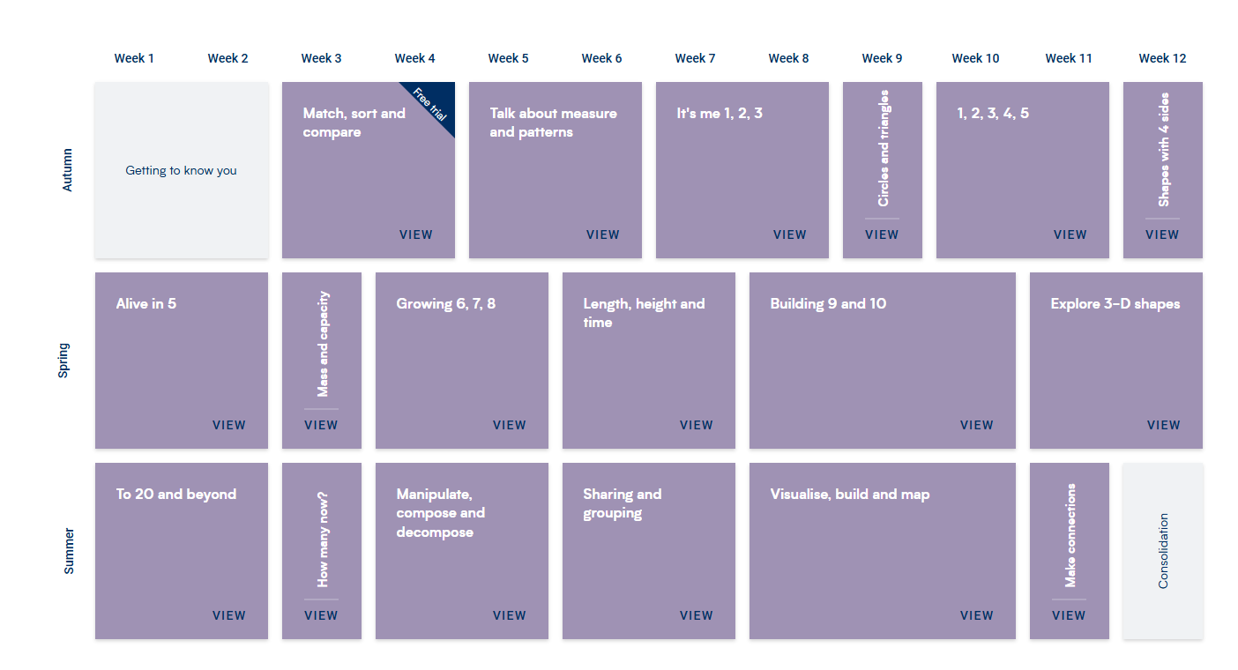
What might this look like in the classroom?
Children may count objects, compare quantities, build with shapes, make patterns, explore capacity in the water area or solve problems through role play. Adults use questions and practical resources to encourage children to think mathematically, explain their ideas and make connections.
The aim is not simply for children to remember numbers, but to develop a deep understanding of how and why maths works, building strong foundations for Year 1 and beyond.

Slide 14
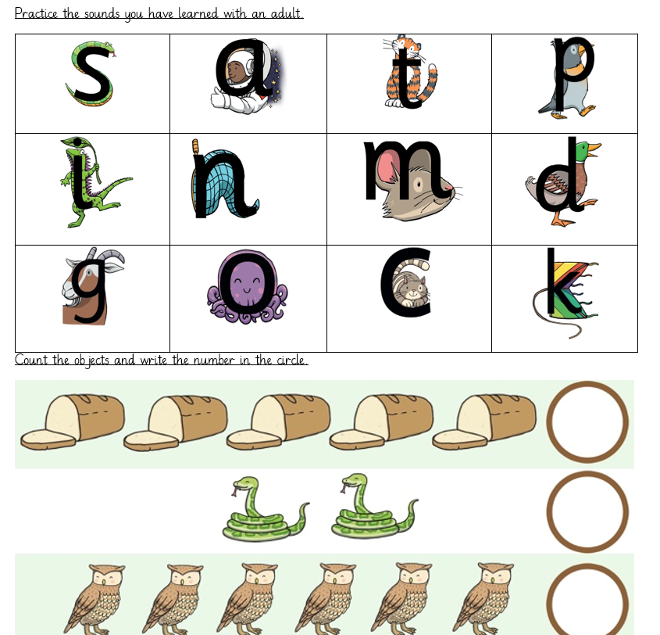
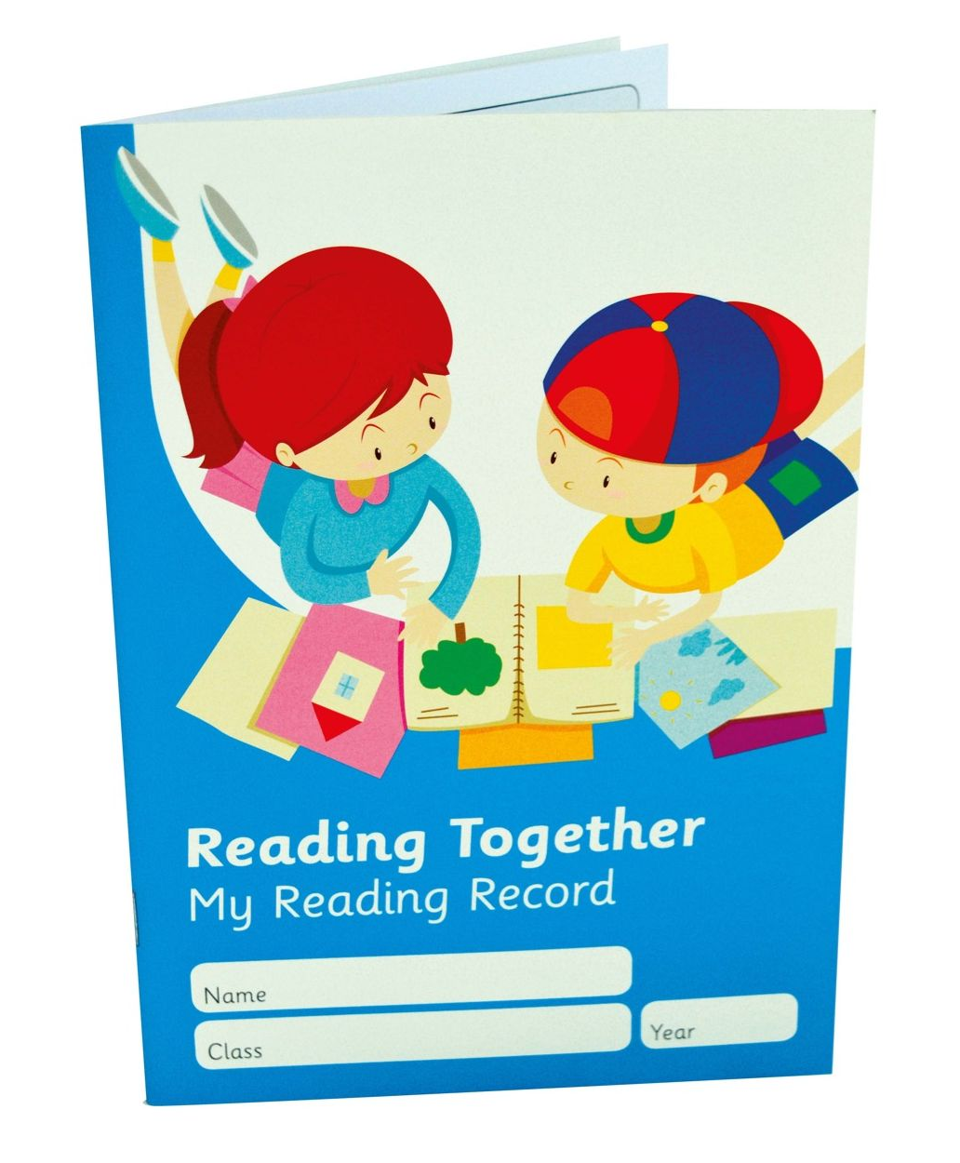
Homework and reading records
(Begins in Autumn 2)

Slide 15
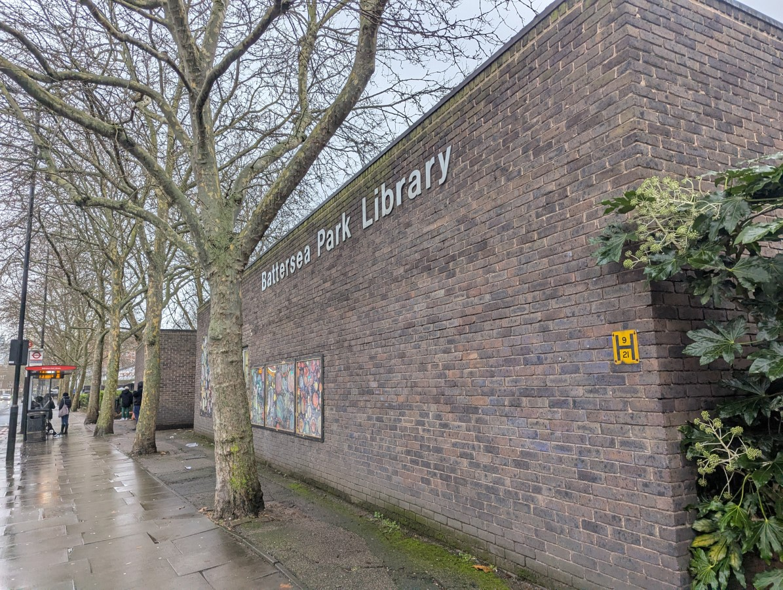
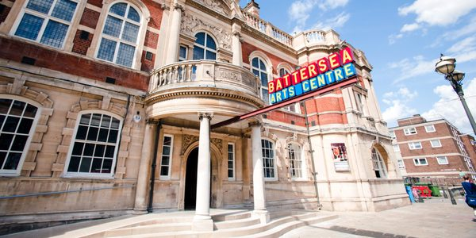
Trips

Slide 16
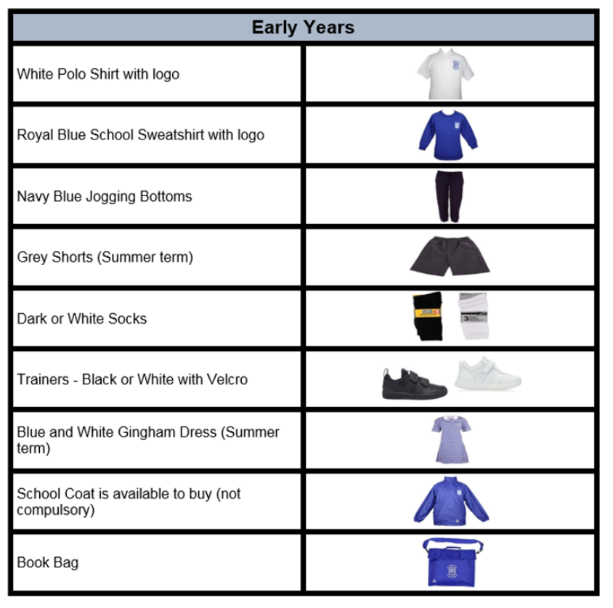
Uniform
Children should bring a “Book Bag or backpack ” to school every day.
Children in Nursery and Reception Class should bring a carrier bag with a change of clothing.
Please ensure your child’s name is written clearly on all items of clothing including hats, scarves and coats.

Slide 17
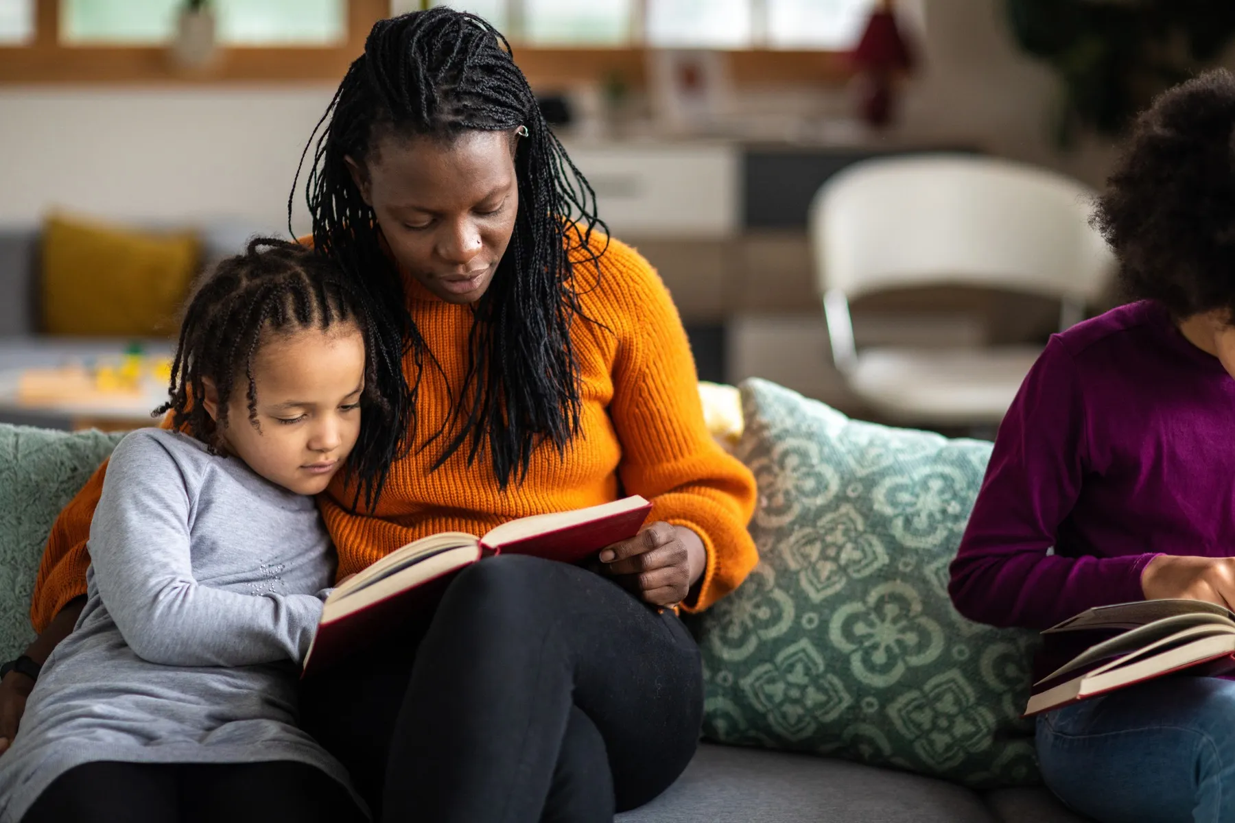
How can I help my child?
Excellent attendance and punctuality (Start and finish times on welcome pack).
Ensure children are wearing the correct uniform-this is VERY important!
Talk to your child’s class teacher if you have any concerns – face to face or class dojo.
Information for parents will be given out half termly (parent overviews)
Read with your child every night at home and sign their reading records.
Complete any homework sent home and ensure it is handed in on time.
Volunteering for school trips if possible.

Slide 18


Slide 19
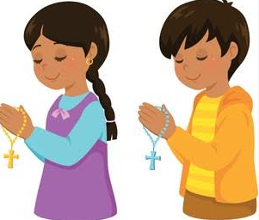
Evening Prayer
God our Father I come to say
Thank you for your love today,
Thank you for my family,
And all the friends you give to me.
Guard me in the dark of night
And in the morning, send Your light.
Amen

