Slide 1

Reception Maths Workshop
St Mary’s Primary School
Welcome Parents and Carers

Slide 2
Aims of the Workshop
To share our approaches to maths at St Mary’s.
To develop parents’ confidence in helping their children with their maths skills at home.
To give an overview of maths and share the learning children do in school.
To give parents an opportunity to ask questions.
To give parents an opportunity to take part in maths activities.

Slide 3
Maths in Reception
Counting
Develop fast recognition of up to 5 objects, without having to count them individually (‘subitising’).
Recite numbers past 20.
Have a deep understanding of number to 10- the composition of each number.
Recall number bonds to 5. addition as well as subtraction facts .
Begin simple addition and subtraction using real objects and number lines
Patterns
Explore and represent patterns within numbers up to 10, odds and evens, doubles and sharing quantities fairly-(dividing)
create ABAB and more complicated ABC patterns – spot errors continue patter. Relate this to number.
Measurement
Make comparisons between objects relating to size, length, weight and capacity.
Name 2D and 3D shapes and explore positional language.

Slide 4
How do children learn maths in Reception?
In Reception we follow White Rose maths schemes, this scheme introduces as concept to the children and give them opportunity to explore this further throughout the week.
Each day we have our session, we will use slides and manipulatives in order for them to be able to explore the concept as we discuss it.
The concept will be explored further in the continuous provision around the classroom so they can embed their learning further and they can make their own learning discoveries.
Simple patterns, such as ABAB or AABB, are through activities like arranging coloured blocks or objects. Recognising and creating patterns is an important skill that will help your child move forward in their learning and help them to spot the patterns that appear throughout number.
Basic measurement concepts like big and small, tall and short, or long and short are explore through activities involving comparison and ordering objects. Filling with water and sand, help deepen their understanding of capacity.

Slide 5
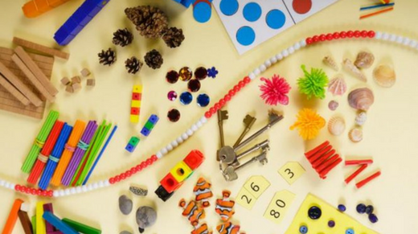
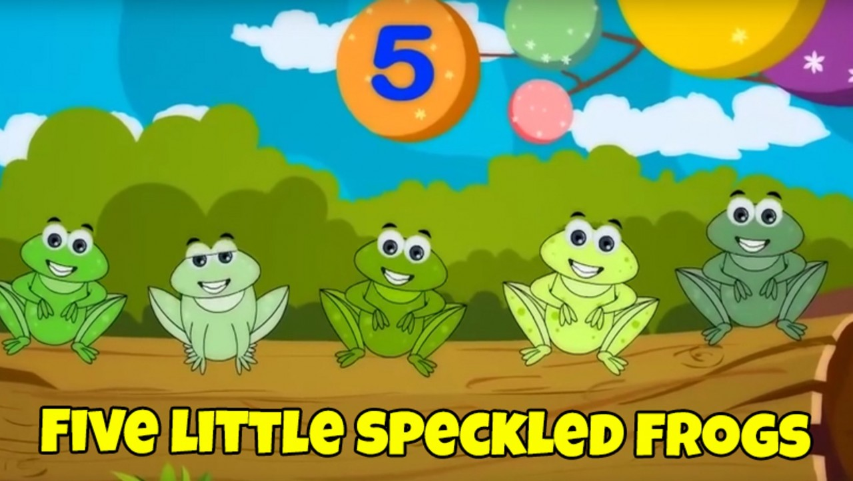
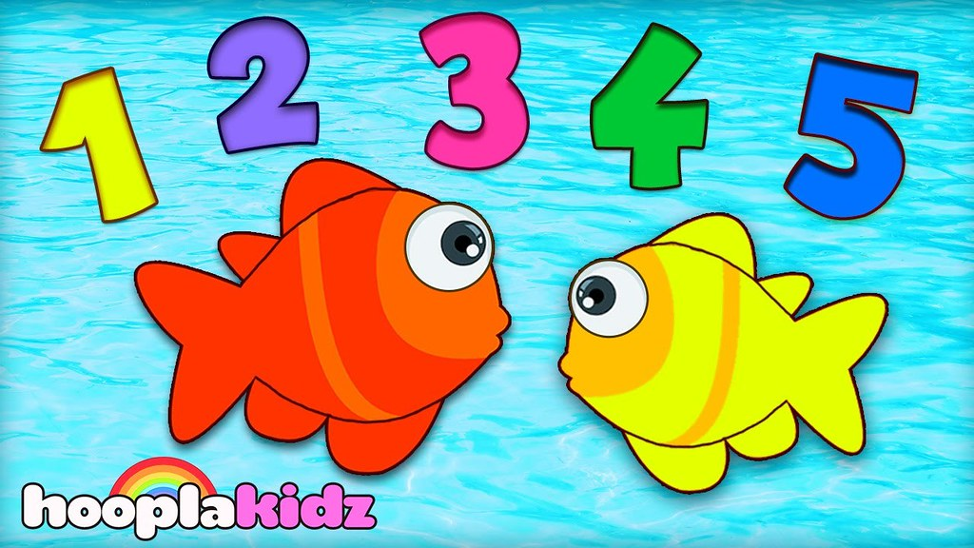
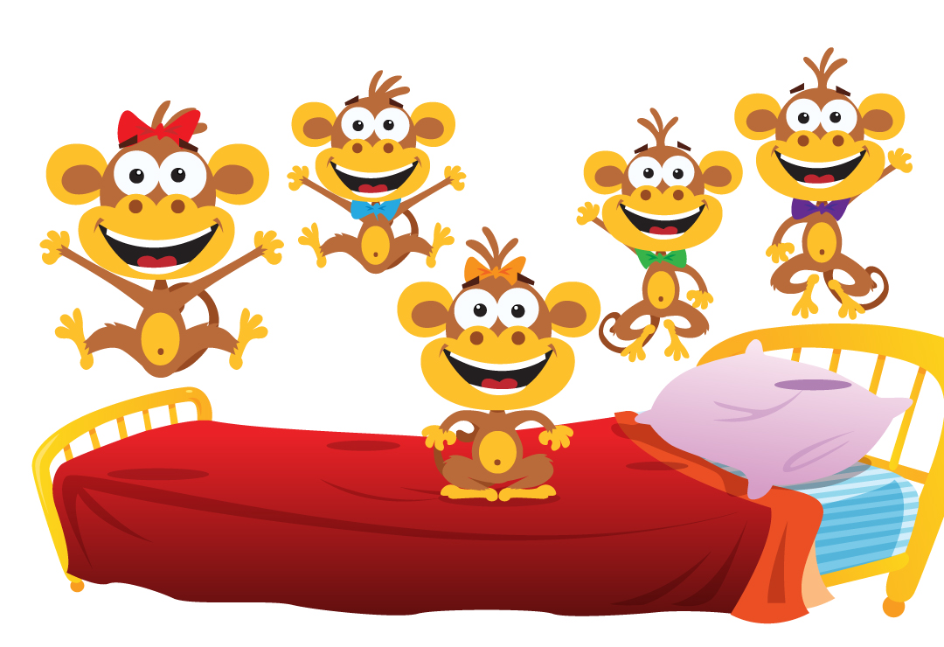
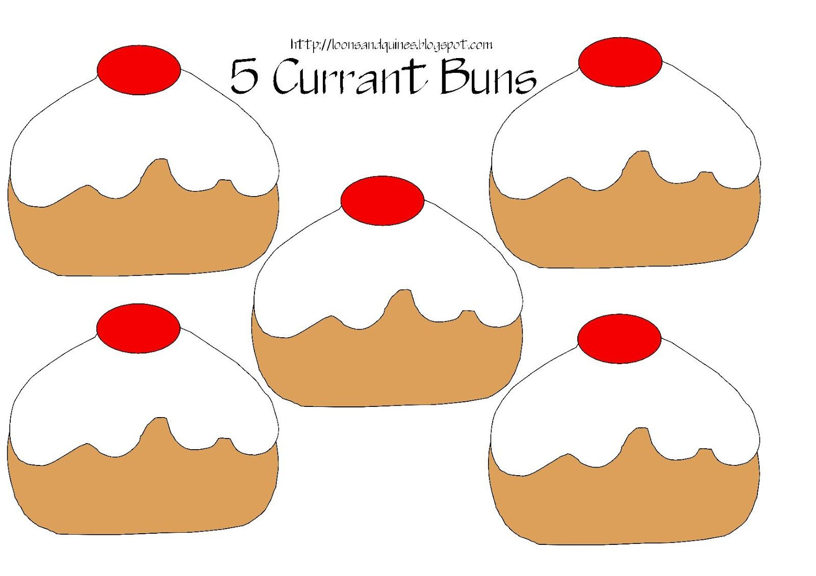
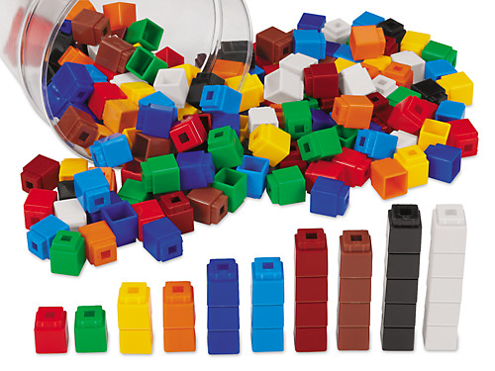
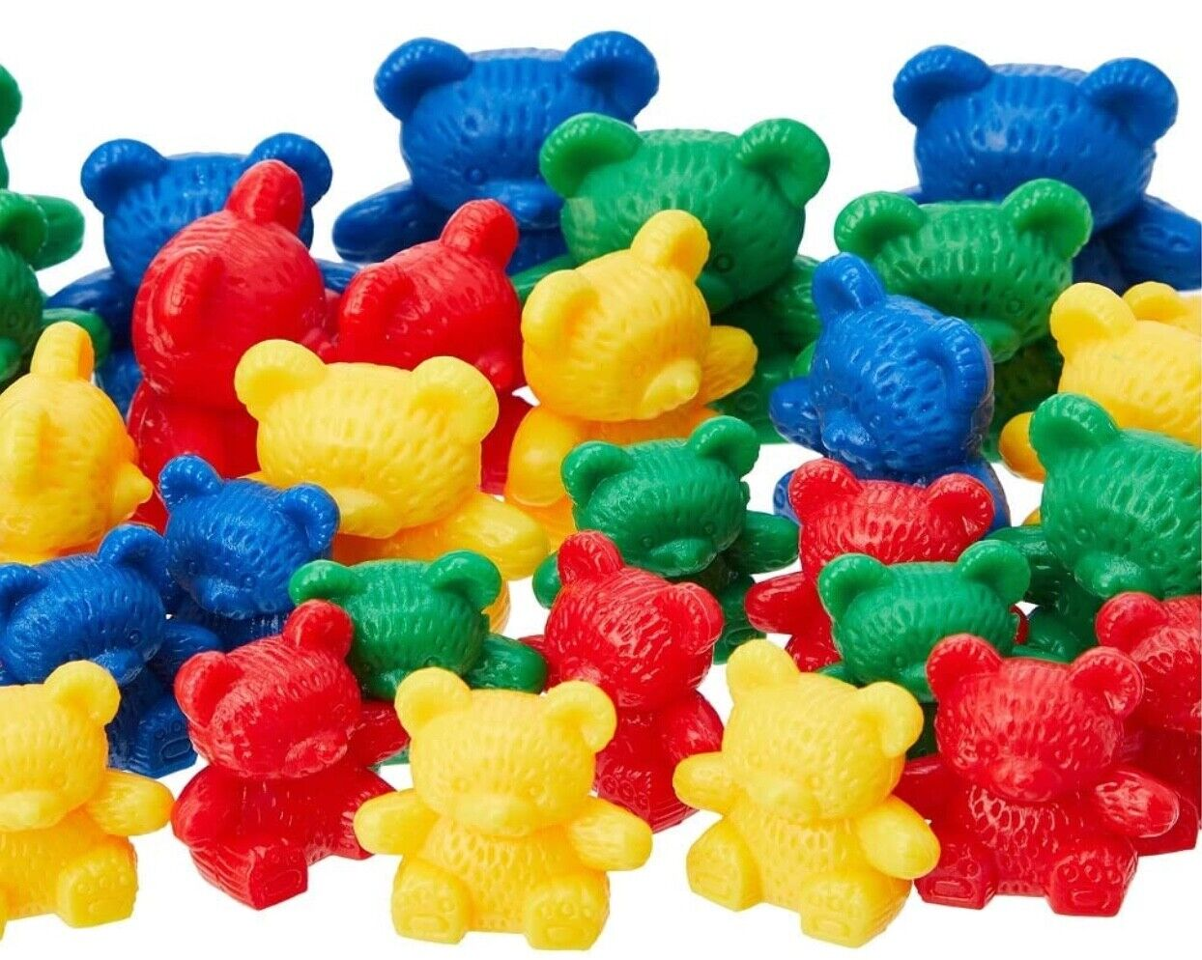
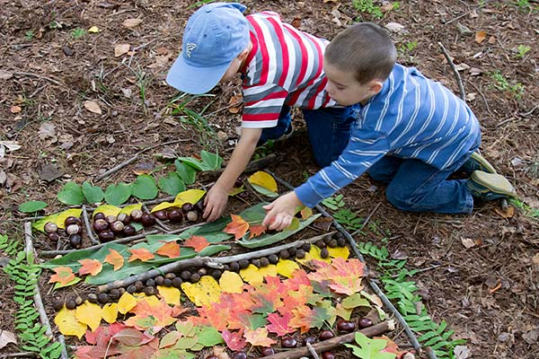
Resources that we use in Reception to teach and learn maths
Manipulatives: Hands-on materials like counting bears, linking cubes, colourful counters, and pattern blocks are commonly used to introduce and reinforce mathematical concepts. These manipulatives help children visualize and interact with abstract ideas.
Books and Stories: Math-themed storybooks and picture books can make learning more enjoyable.
Counting Songs and Rhymes: Music and movement are effective tools for engaging young learners. Counting songs and rhymes help reinforce counting skills in a fun and memorable way.
Daily Life Materials: Incorporating everyday items, such as buttons, beads, snacks, and other household objects, into math activities can make learning more relatable and practical.
Number Cards and Charts: Large and colourful number cards are used to introduce numerals. These visuals aid in number recognition and counting.

Slide 6

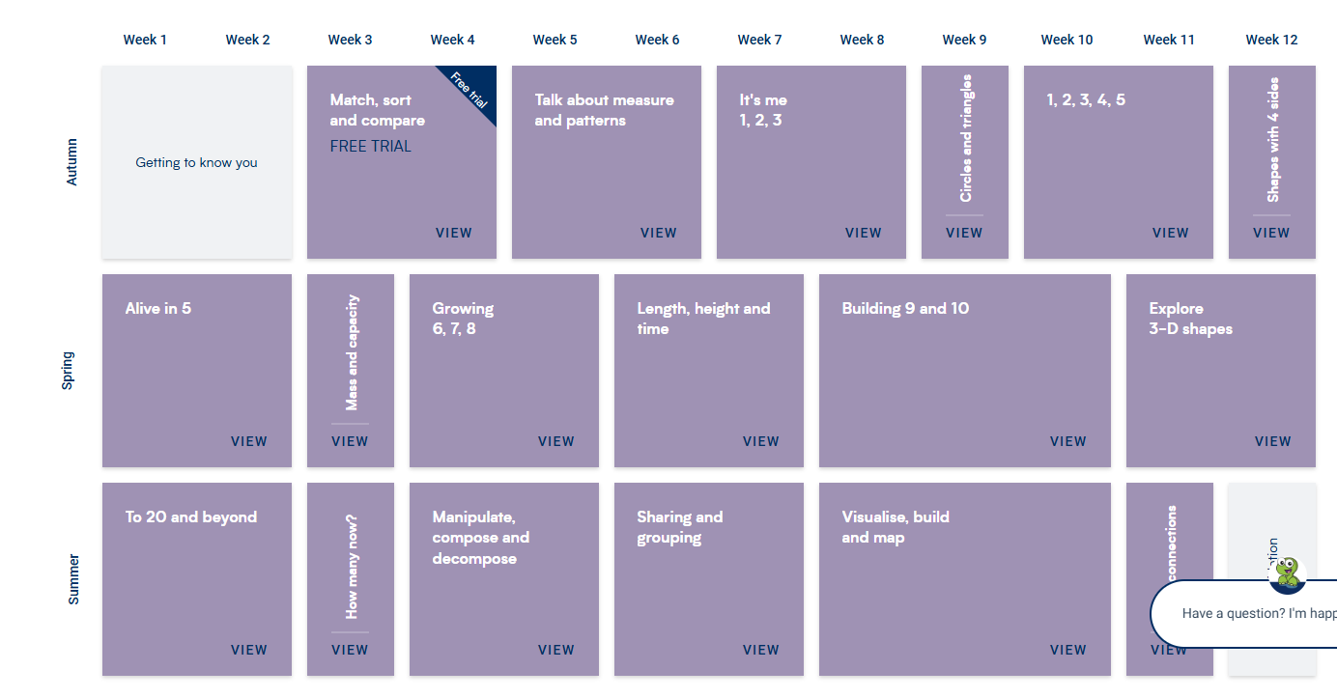
White Rose Maths

Slide 7
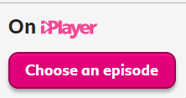
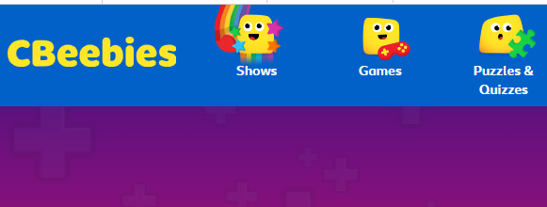
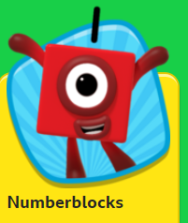
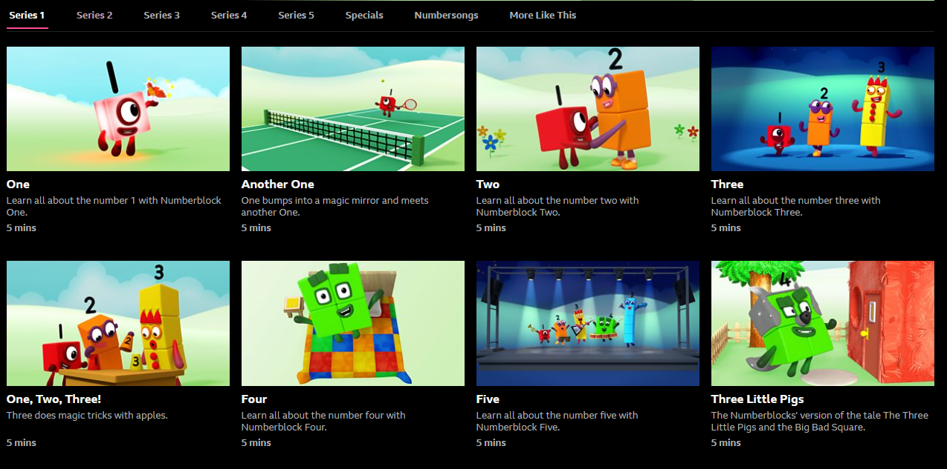
Online resources and videos that we use

Slide 8
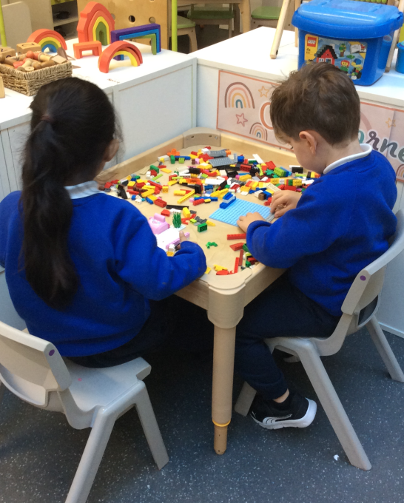
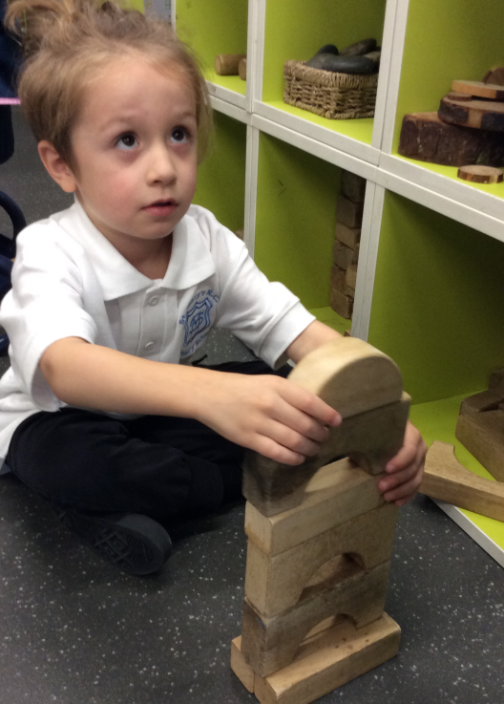
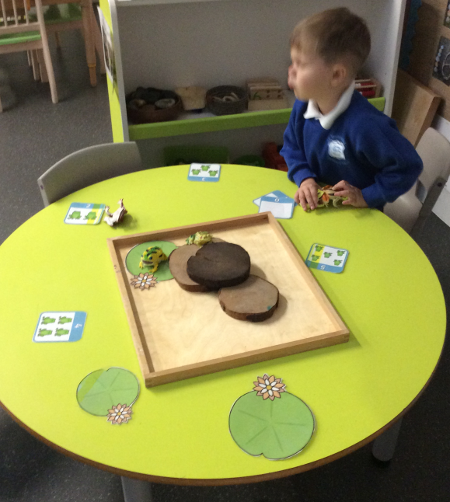
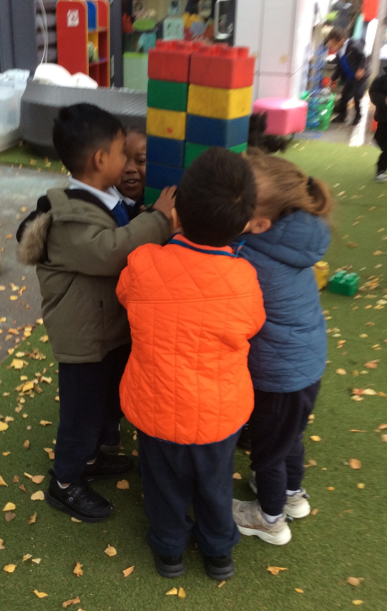
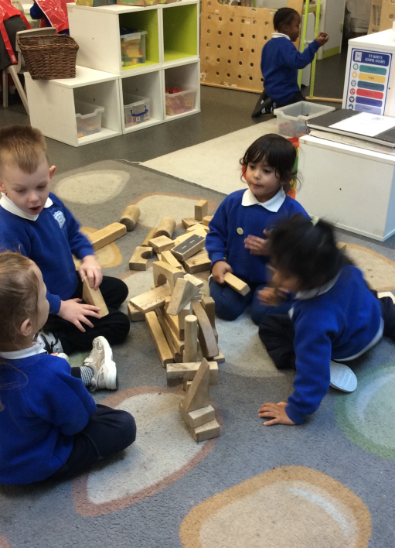
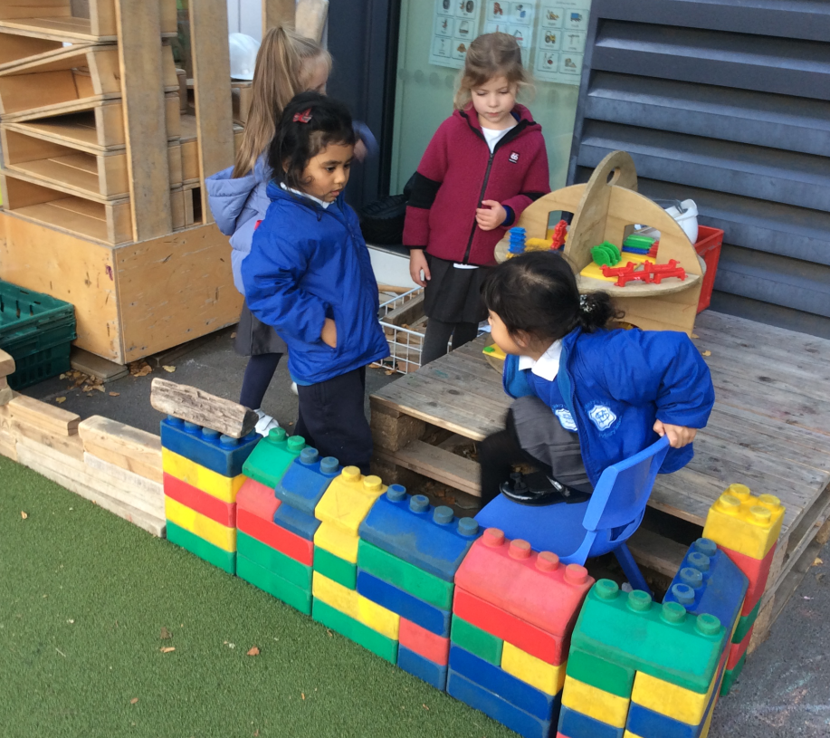
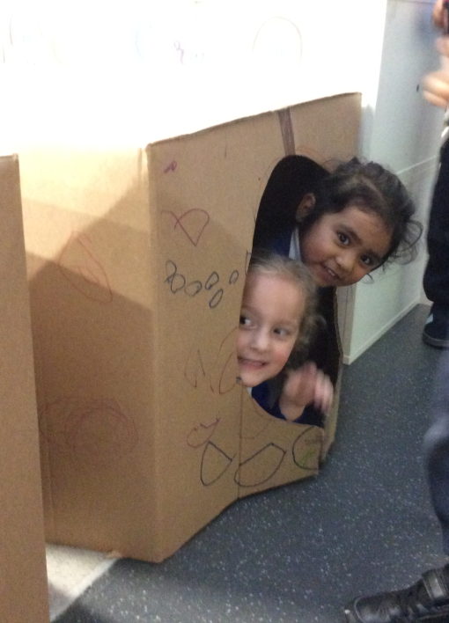
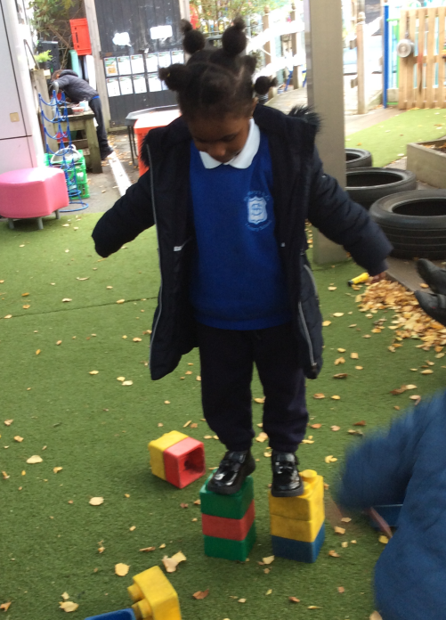
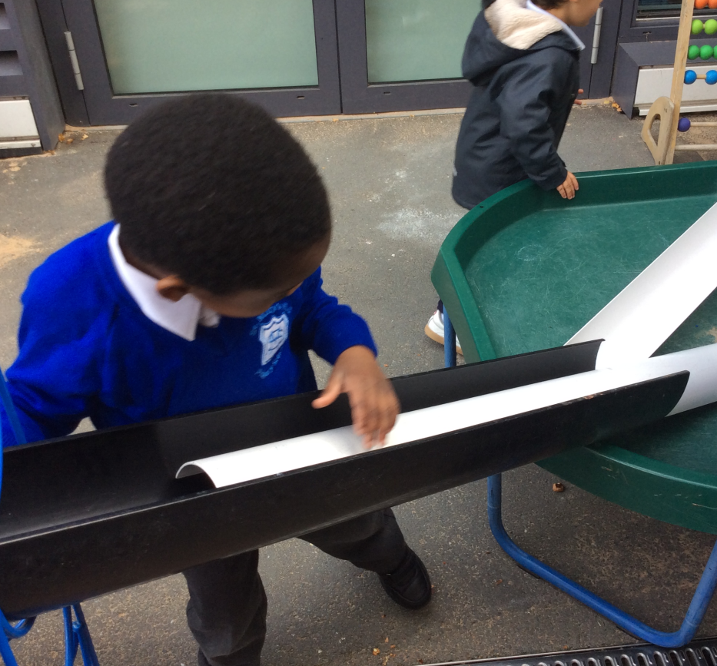
Learning in Reception

Slide 9
Ways to support your children at home
It’s important to remember that informal and playful interactions are key at this age. The goal is to make math enjoyable and to foster a positive attitude toward learning. You can weave math into daily activities, turning routine moments into opportunities for exploration and discovery.
Build Maths Into Daily Routines
Counting everywhere
Count steps on the stairs, apples in a bowl, cars on a walk, toys as you tidy.
Practise counting forwards and backwards.
Use real-life maths
Let them help measure ingredients when cooking.
Talk about time: “In 5 minutes we’re leaving,” “How long will the pasta take?”
Handle money: look at coins, talk about value, pretend-play shops.
Encourage Mathematical Language
Introduce words like:
Big/small, more/less, full/empty, heavy/light
First, next, last
Square, circle, triangle
Use them in natural conversation:
“Which cup has more juice?”
“Can you find the biggest teddy?”

Slide 10
Home work
Homework is sent out on Thursdays and will include a maths task.
Please make sure your child completes this to the best of their ability and expand on it if they need further challenge.
Home work is handed in by tuesday ( best to keep over weekend)

Slide 11

Celebrate Their Thinking,
Not Just “Right Answers” Praise effort and reasoning:
“I love how you tried a different way.”
“Can you show me how you worked that out?”
This builds confidence and a positive attitude toward maths.
Use Technology Sparingly
Short, high-quality apps can help, but should not replace hands-on play.
Good options include:
Numberblocks (videos + games)
Top Marks Early Years games
CBeebies Counting games.

Slide 12
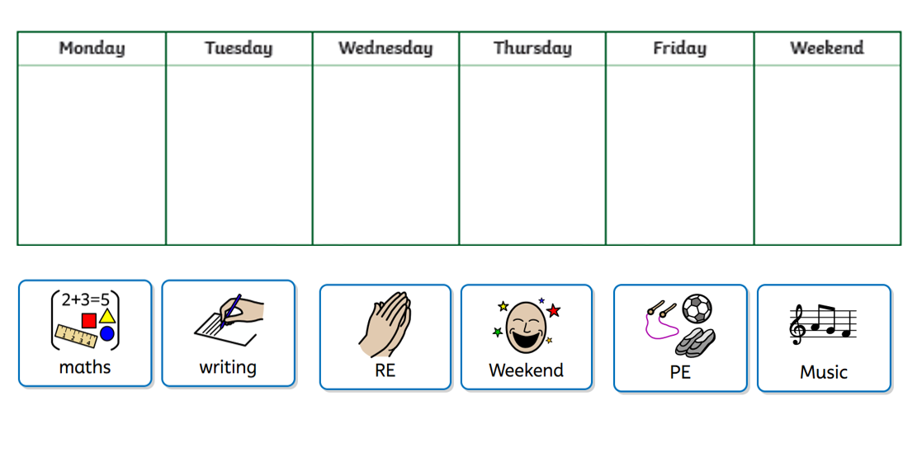
Please have a go at completing the following task with your child…

Slide 13
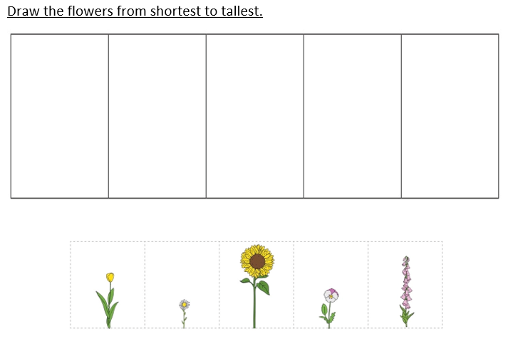
Homework this week…

Slide 14


Slide 15

Please complete the QR survey before you go…

