Slide 1
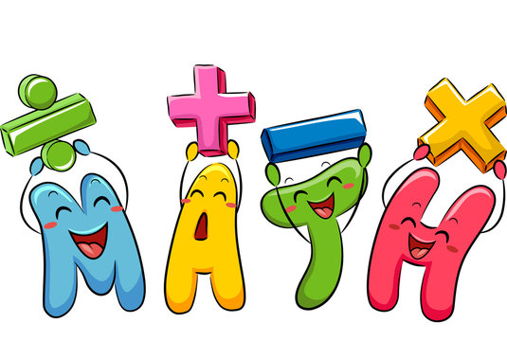
Welcome to Year 1
Family learning
Focus: Maths
Notes:
Welcome everyone and thank you for coming. Today we will look at how maths is taught in Year 1, what your child is expected to learn, and how you can support them at home in simple and effective ways.

Slide 2

Why Maths is important in Year 1
Builds strong number foundations
Develops problem-solving skills
Supports everyday life (time, money, measure)
Builds confidence and resilience
Notes:
Year 1 is a crucial stage where children move from early counting into deeper understanding. It’s not just about getting answers right, but understanding how numbers work and explaining their thinking. Our Goal
We want children to become:
✔ Confident
✔ Curious
✔ Problem solvers
Maths should feel fun and achievable.

Slide 3


Our approach – Maths Mastery
Children learn maths through:
Focusing on deep understanding
Small steps learning
Use of concrete, pictorial and abstract methods
Everyone can succeed in maths
Notes:
We follow a mastery approach, which means children spend longer on key concepts to fully understand them. We use objects, pictures, and numbers to help children learn in different ways. Our teaching is guided by the White Rose Maths scheme and NCETM. These help ensure lessons are structured, progressive, and focused on deep understanding rather than rushing ahead.

Slide 4
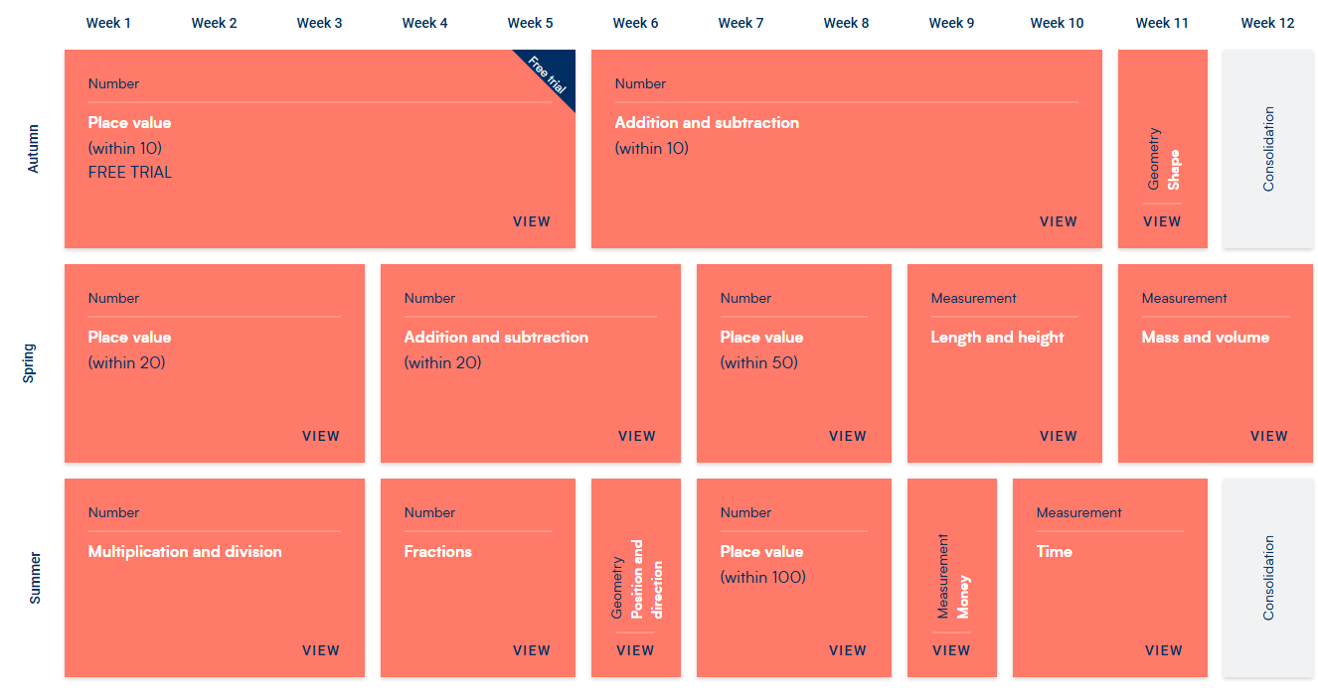
Notes:
There are 4 mail elements of maths within the National Curriculum.
Number
Number and place value
Addition and Subtraction
Multiplication and Division
Fractions
Measurement
Length, mass, volume/ capacity and temperature
Money (GBP)
Time – five minute intervals, o’clock, half past, minutes, hours, days, weeks and months
Geometry
Properties of 2D and 3D shapes
Position and Direction – N,E,S,W, rotations, and patterns
Statistics
Pictograms, tally chart, block diagrams, creating and interpreting data

Slide 5
Key Maths Skills in Year 1
By the end of Year 1 children should be able to:
Count to and across 100
Read and write numbers to 100
Add and subtract within 20
Understand place value (tens and ones)
Recognise basic shapes
Tell the time (to the hour and half hour)
Notes:
These are some of the key skills your child will develop this year. We break these down for children in manageable chunks throughout the year so they have time to build on their skills. We start with learning about place value within 1-10 and securing our place value knowledge before we move on to addition and subtraction. Some children will move beyond these, but secure understanding is more important than speed.

Slide 6
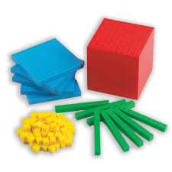
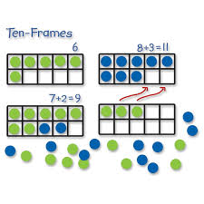
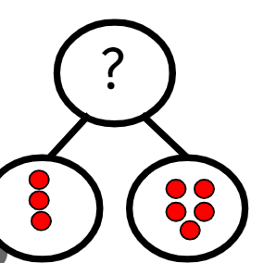
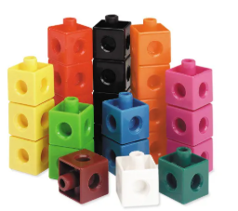
How we teach maths
Use of manipulatives (counters, cubes)
Visual representations (number lines, part-whole models)
Mathematical talk and reasoning
Notes:
You might see your child using objects or drawing pictures to solve problems. This is intentional and helps them understand the maths rather than just memorising answers.

Slide 7



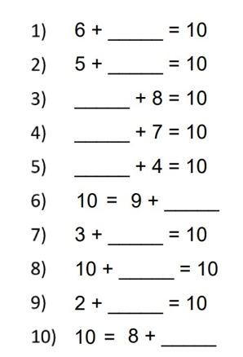

In year 1, we have:
Daily Maths sessions lessons
Daily arithmetic & some small group Maths interventions
Mathletics/Mathseeds
10/10 club 20/20 club

Slide 8
Modelling a Task
Question: 8 + 5 = ?
Notes:
We encourage children to use strategies like making 10. At home, you can model this using objects like buttons or toys to help them see how numbers work.

Slide 9
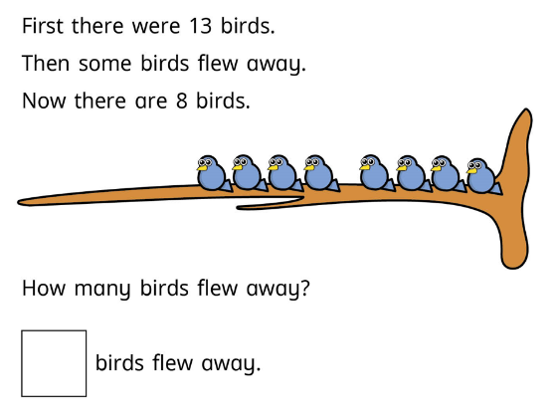
?
What knowledge/skills do you think we
need to know before working out this question?
Notes:
Subtraction is often taught by counting back or finding the difference through First, then and now stories. Encourage your child to explain their thinking as they work.
What do you need to know before being able to work this question out?

Slide 10
Practising Number Facts
By the end of Year 1 children should be able to fluently know: Number bonds to 10 & 20
Example:
3 + 7
5 + 5
6 + 4
Why Number Facts Matter
When children know number facts well, they can:
✔ Solve maths problems more quickly
✔ Focus on understanding the problem rather than counting each time
✔ Build confidence in maths
✔ Develop mental maths skills
✔ Prepare for more complex maths in later years
Notes:
You can practise through:
quick questions
card games
number bonds games
What We Mean by “Fluency”
Fluency means children can:
recall facts quickly
answer without counting each time
use facts to solve new problems
For example:
Instead of counting fingers for
5 + 5
Children begin to just know it equals 10.

Slide 11
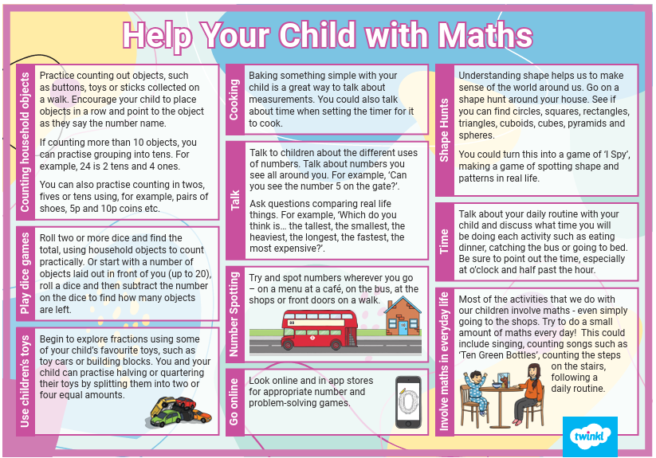
Use Real Life
Maths is everywhere:
“We have 7 grapes. If we eat 2, how many left?”
“You have 5 toys and get 3 more.”
How Parents Can Help at Home
Short and regular practice works best.
Practice reading and understanding the 12-hour analogue clock
Quick Daily Questions
Ask simple questions like:
What makes 10 with 6?
What is one more than 8?
What is 10 take away 4?
Importance of Homework
Reinforces learning
Builds independence
Helps identify gaps
Reading and writing numbers (written and digit form) within 100
Notes:
What If My Child Finds Maths Tricky?
That’s completely normal.
Ways to help:
Encourage them to try
Praise effort
Let them use objects (counters, fingers)
Maths understanding develops over time.
You don’t need to be a maths expert to help your child. Everyday activities like counting steps or sharing food can make a big difference.
Homework is designed to practise skills taught in class. It’s important children attempt it independently, but with your encouragement and support.
Its all about the language you use and connecting real life experiences to create meaning. The most important thing is helping your child feel confident and positive about maths. Mistakes are part of learning.

