Slide 1

Year 4 open classroom
Monday 15th September 2025

Slide 2

The Year 4 team
Mr Shoubber
Miss Kelly

Slide 3
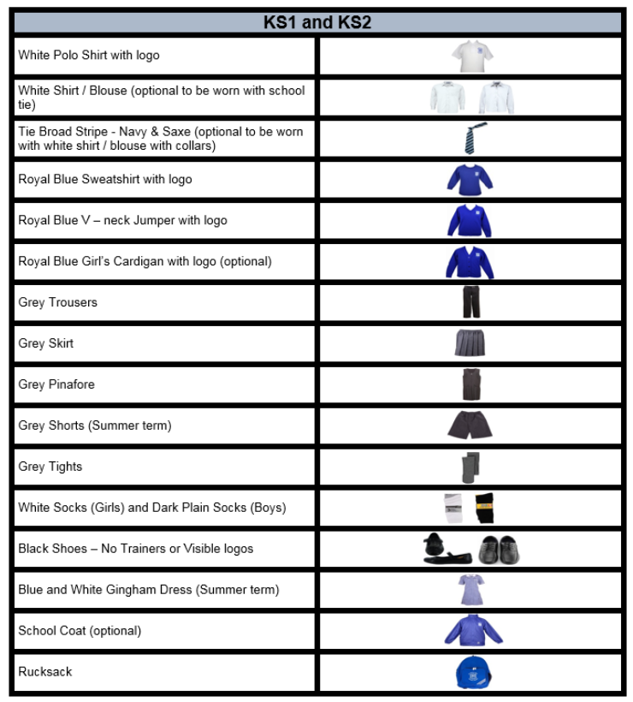
Uniform Expectations

Slide 4
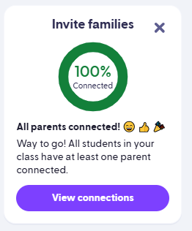
Behaviour systems in Year 4
Sun and clouds
Class Dojo
Certificates
Hot chocolate Friday (ice lolly in the summer)

Slide 5
Year 4 Class charter
During PSHE at the start of the year, we came up with 4 key rules for our classroom to ensure everyone is happy, safe and able to learn:
- We listen to the speaker and don’t interrupt
- We look after our classroom and the school’s property
- We are kind and polite to everyone
- We do our best and try to make learning fun

Slide 6
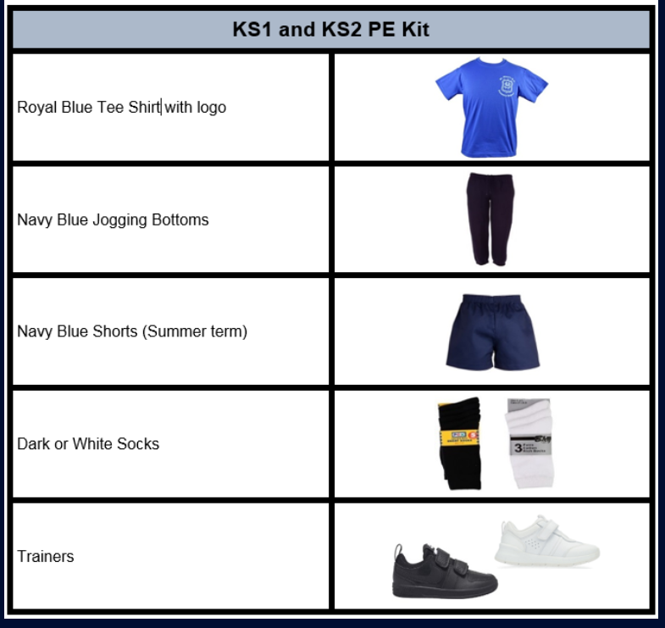
PE days
Monday (with me or Miss Kelly)
Wednesday (with coach Ashley)

Slide 7

Reading
Aim to read daily - reading records to be signed by an adult/the child
Our library has many interesting and exciting books, including non-fiction and fiction across a range of genres – please have a browse after the session!
We are trying to drive reading for pleasure forward as a
whole school this year

Slide 8

Homework
Written homework is given out on a Thursday and is to be returned by Tuesday.
  Typically: English, spellings, maths
  Mathletics and TT Rockstars assignments and sessions ongoing each week
  Homework club (Mondays after school) can be very helpful (and is free!)

Slide 9
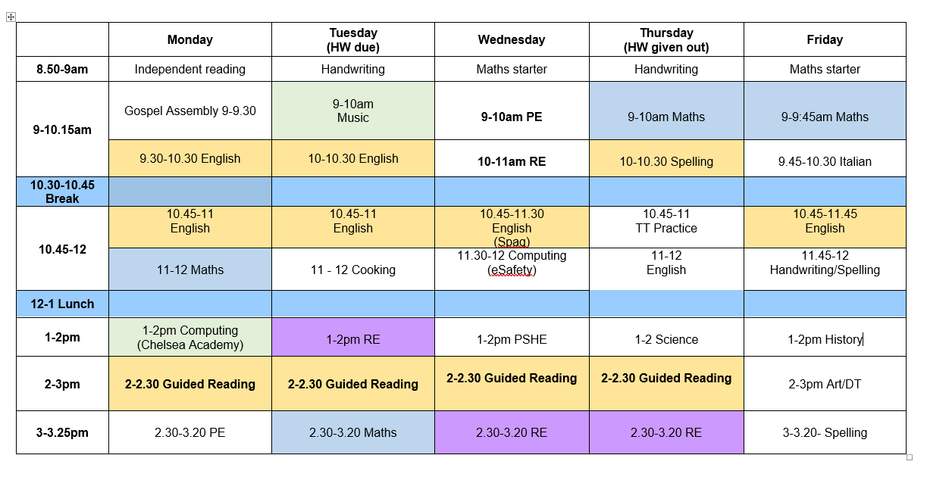
Our weekly timetable

Slide 10

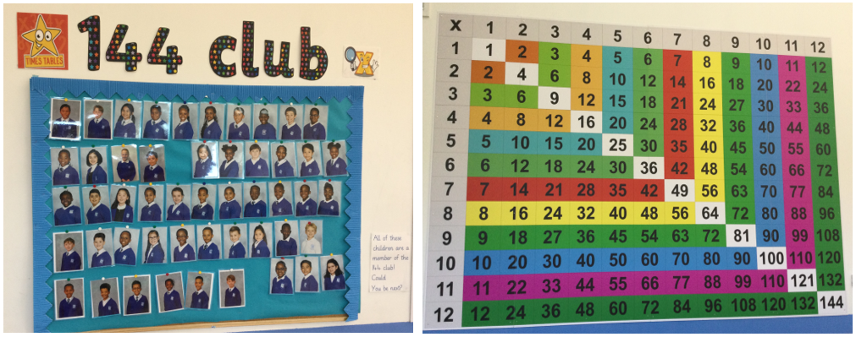
Year 4 Goals

Slide 11

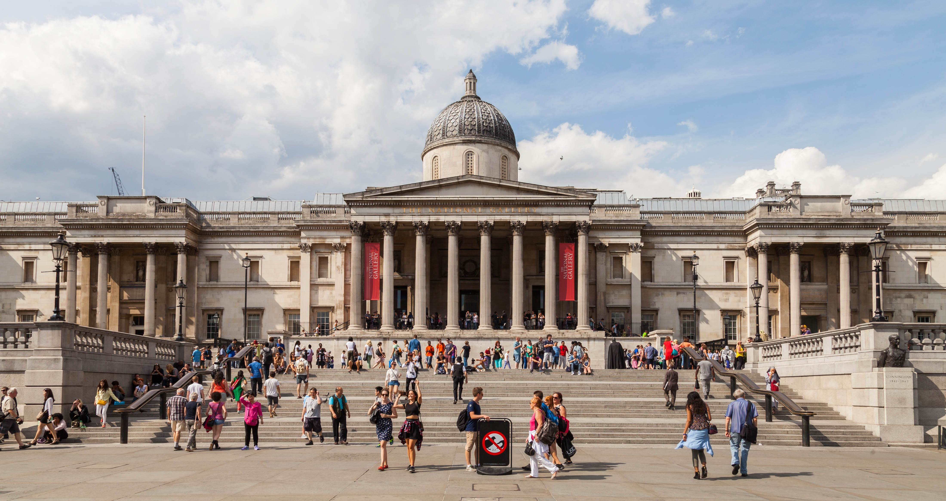
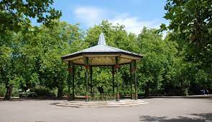
Trips in Year 4
Today we had our first trip to Ark Putney which was a success!
Future trips may include: The British Museum, Natural History museum, Battersea Park, The National Gallery, Sports events (later in the year).

Slide 12

Key dates – all will be shared and reminded on Class Dojo
Start of year mass Friday 26th September 10:00am
Year 4 class assembly Thursday 9th October
Year 4 MTC June 2026 (exact dates tbc – further info will be shared at a future family learning session)

Slide 13

Prayer
Daily prayer in class (morning, before lunch and end of the day
Collective worship in Monday’s gospel assembly, and in class daily.
Regular mass at church

Slide 14
We live, love and learn together
in the light of God by…
Praying together,
Learning together,
Playing together,
And respecting each other.
Amen

