Slide 1

Year 2 open classroom
Wednesday 10th September 2025
2

Slide 2

The Year 2 team
Miss Hunt
Ms Barbara
Mrs Payne

Slide 3
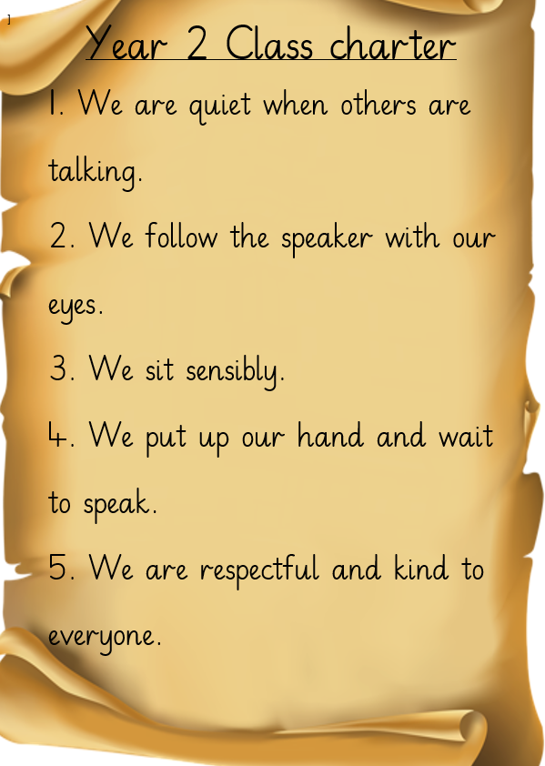


Slide 4
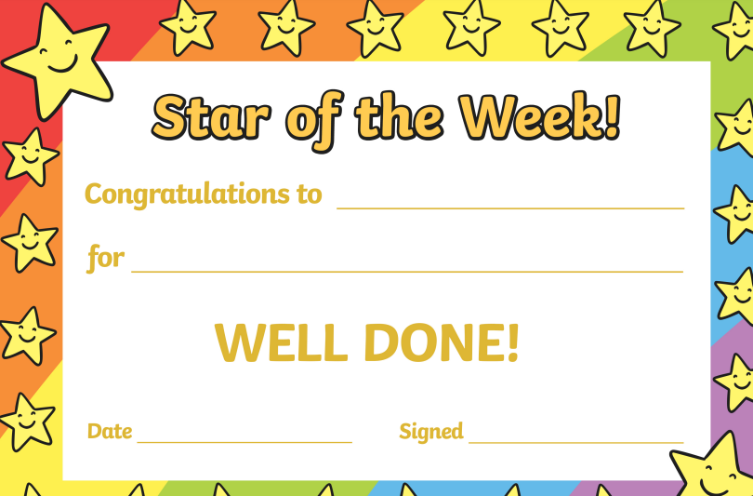
Behaviour systems in Year 2
Sun and clouds
Class Dojo
Star of the Week
Learning behaviour certificates (Half-termly)
Hot chocolate Friday/ ice lolly Friday

Slide 5
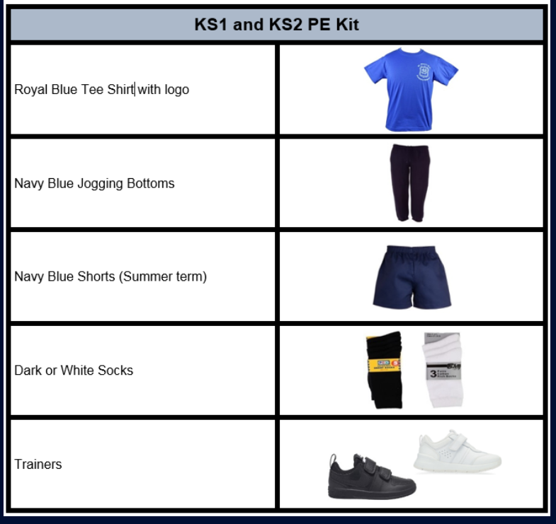
PE days
Thursday (Ms Hunt)
Friday (Coach Ash)
Full uniform other days.

Slide 6

Reading and Phonics
Reading is to be done daily and reading records are to be signed by adult.
Children will take home a book of their choice (changed weekly) and a Phonics book (changed weekly).
Books and reading records should be brought in every day.

Slide 7
Year 2 Homework
Daily reading
Weekly spellings
1 piece of English homework (this could include Reading comprehension or handwriting)
1 piece of Maths homework (including number facts)
Homework is given out on Thursday and returned on Tuesday.

Slide 8
Year 2 Homework
If a part of homework is tricky for your child, they can put a star or you can write a message for me.
*Homework help available on Friday and Monday*
Challenge homework will begin this week (encouraged but optional)
Mathletics (extra Maths work- weekly tasks)
Homework is given out on Thursday and returned on Tuesday.

Slide 9
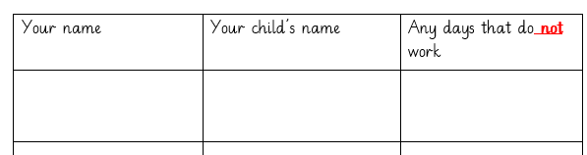
Trips
Please complete the sign up sheet if you would like to join us on a trip this year.

Slide 10

Lastly, we are all a team
Any concerns about learning, behaviour or any other issues in school- please let me know.
We want happy children in school who are ready to learn.

Slide 11

Question time/ look around the classroom time!
Thank you for coming!

