Slide 1

YEAR 1 OPEN CLASSROOM
Monday 8th September 2025

Slide 2

The Year 1 team
Miss Sambi
Ms Sam
Miss Barbara

Slide 3

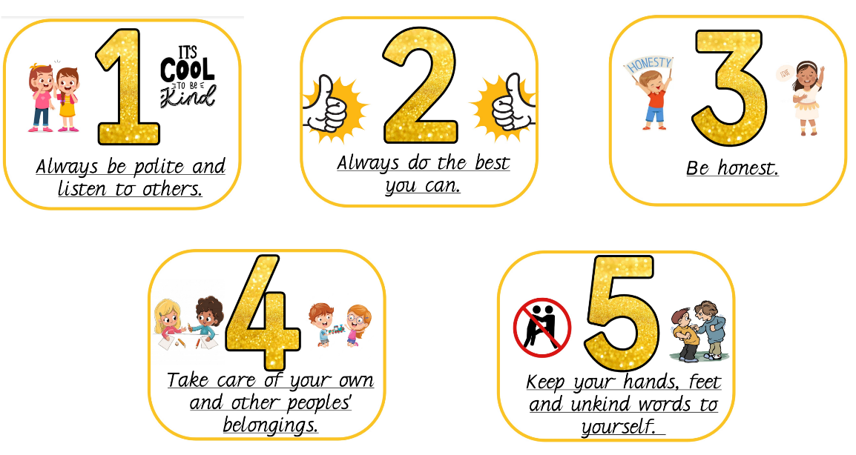
Our class rules in Year 1
On the first day of Year 1 we collaborated as a class to think of some class rules that we thought were important.

Slide 4

Behaviour systems in Year 1
We primarily use positive reinforcement in Year 1.
Star, sun and clouds
Class Dojo
Pupil of the day
Certificates/ stickers
Hot chocolate/ Ice lolly Friday

Slide 5

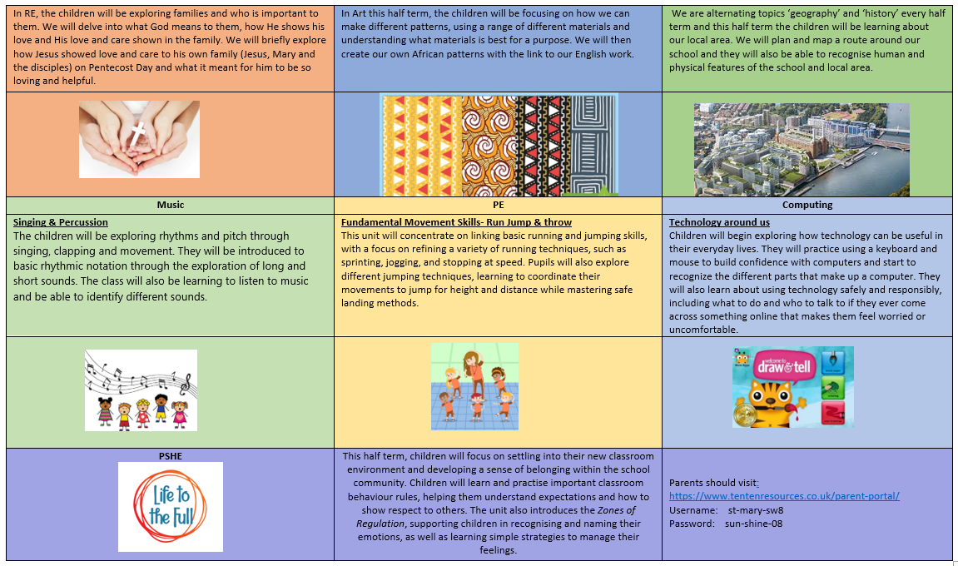
Half termly Parent Overviews

Slide 6

Homework and reading
Reading is to be done daily and reading records are to be signed by an adult. We will be sending a book home that matches their phonic knowledge and a book for pleasure.
Reading books must be brought in EVERYDAY as we use them in our reading practise sessions.
Homework is sent out on a Thursday and is to be returned on a Tuesday.
Handwriting, English, Maths, Topic, Spellings
We have high standards of presentation; children should be practising writing on the line and forming their letters correctly. Children should be writing in pencil. Not pen or colouring pencils.

Slide 7
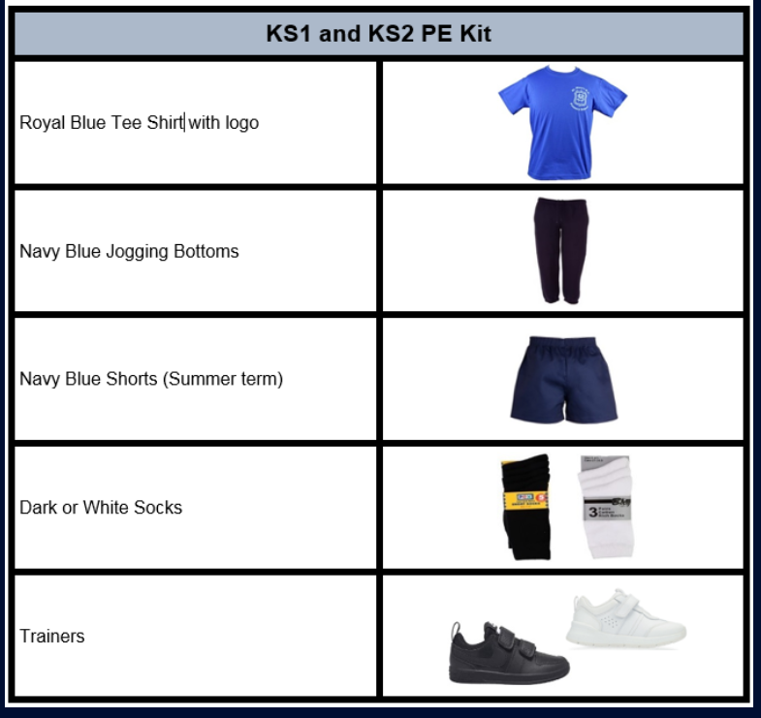
PE days
Monday & Friday
Label EVERYTHING!
Trainers must be appropriate for sport not fashion.
(if trainers have laces, please teach your child how to tie them)

Slide 8
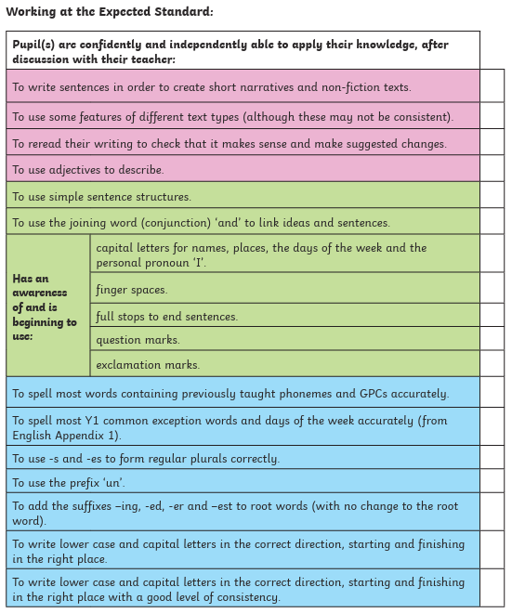
Writing expectations for Year 1
We will be working throughout the year to build these skills.
This is what a child needs to be able to do independently by the end of year 1 to be ‘on track’.

Slide 9
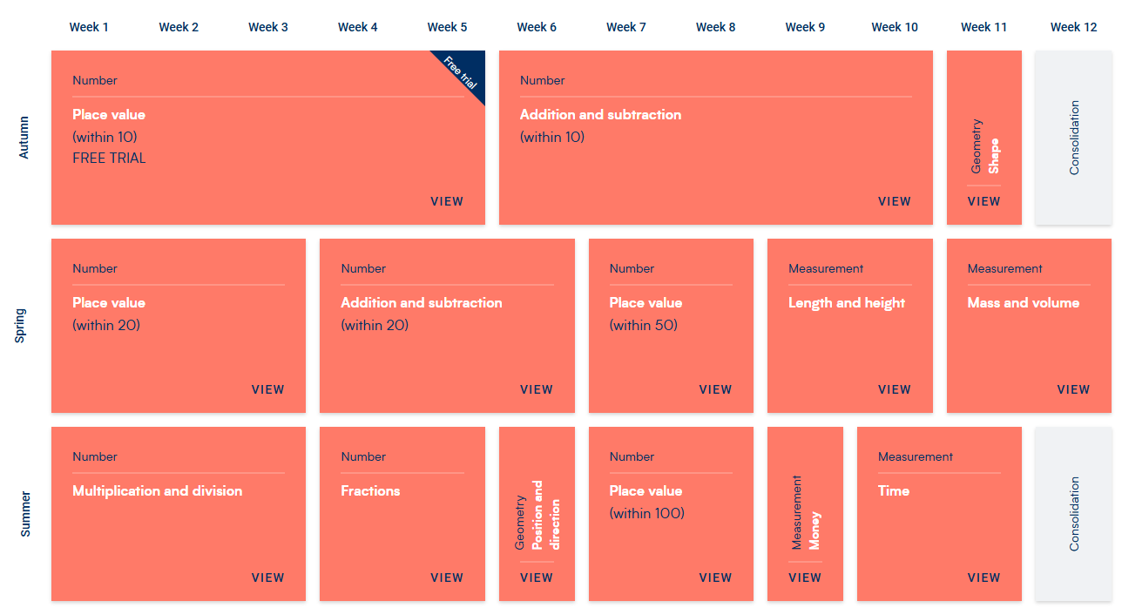
Maths
We follow ‘White Rose’ maths scheme
We will cover these units throughout the year

Slide 10

Trips
We will be going on some exciting trips throughout the year.
There may be times we need parent volunteers. If this is the case, I will send a message asking for names (numbers may be limited depending on the trip)

