Slide 1

Wednesday 17th September 2025
Welcome to Year 5 Open Classroom
From small seeds, great lives grow.

Slide 2

Meet the team:
Class teacher: Mrs Jerry
Class TA: Mrs Kelly and Mrs Viegas

Slide 3

On the first day of Year 5, we created our own class rules and signed them promising we would would try our best each day to follow them.

Slide 4

At St Mary’s, behaviour is rooted from the teaching of Gospel Values and of the Catholic Church into every aspect of learning. This term, our focus will be ‘dignity’.
Behaviour Policy

Slide 5
Behaviour Policy
-Sun, warning 1 and 2 clouds
- Class Dojo
- Raffle tickets
- Learning behaviour certificates (termly)
-Hot chocolate/ice lolly Friday

Slide 6
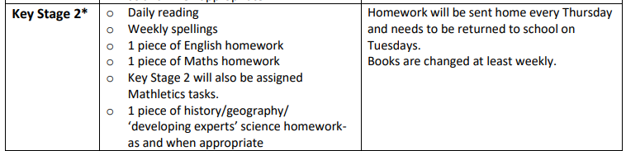
Homework
-Sent out on Thursday, returned on Tuesday. Spelling tests will be on Tuesday mornings.
-Mathletics to be completed, if a device is an issue, then let us know.
-Reading record signed daily, either by adult or child- adults must sign it at least once a week.
-Reading books will be changed and monitored when needed.

Slide 7

Reading for pleasure
We are focusing on reading for pleasure – helping children discover the joy and excitement that books can bring.
Research shows that reading for pleasure can:
Improve vocabulary and writing skills
Strengthen imagination and creativity
Support emotional wellbeing
Boost academic success across all subjects
We encourage you to spend a little time each day sharing stories, talking about books, and letting your child choose what they enjoy reading. Together, we can nurture a lifelong love of reading!

Slide 8
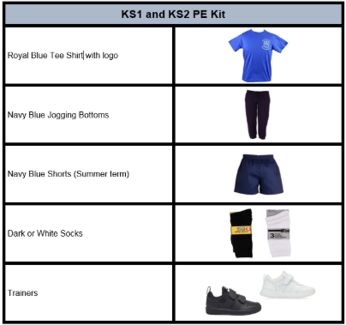
PE days are Wednesday and Friday with Coach Ashley.

Slide 9

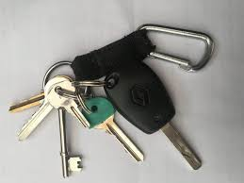

Personal belongings
If your child needs to bring a phone or keys to school, these must be placed in the phone box, which will be kept safely in the school office.
We kindly ask that children do not bring in personal belongings such as stationery or toys. These can cause unnecessary disruptions to learning, and staff cannot be responsible for any loss or damage.

Slide 10
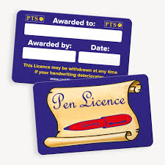

Goals
Pen licence
144 club

Slide 11
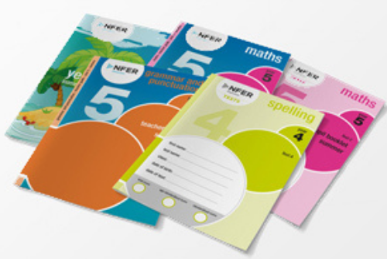

Assessments
NFER
These take place at the end of each term and consist of:
1 spelling
1 Grammar
1 reading comprehension (over 3 different texts)
1 Arithmetic
2 maths reasoning.
Writing assessments in English every half term. This term, your child’s writing will be assessed through a diary entry from the book ‘Skellig’.

Slide 12

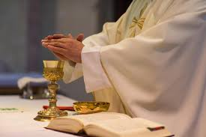

Dates for the diary
Author visit in school: Tuesday 23rd September 2:40pm
Start of term Mass: Friday 26th September 10am at Our Lady of Mount Carmel Church
Year 5 class assembly: Thursday 2nd October 9am
NFERS: Week beginning 6th and 13th October

Slide 13


Slide 14
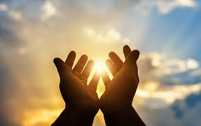
Prayer
Loving God,
We thank You for gathering us here at the start of this new academic year.
Bless our children as they learn and grow,
our parents as they support and guide,
and our staff as they teach and care.
Fill our classroom with friendship, respect and joy.
Help us to live out the Gospel value of dignity,
treating each other with kindness and love.
May this year be filled with learning, laughter and faith.
Amen

